Slide 1

Tool for Infrastructure System Resilience Evaluation
Howard Tong, MSc Student
Andre Schardong, Post Doctoral Fellow
Slobodan P. Simonović, Professor
Mar 23 2017

Slide 2
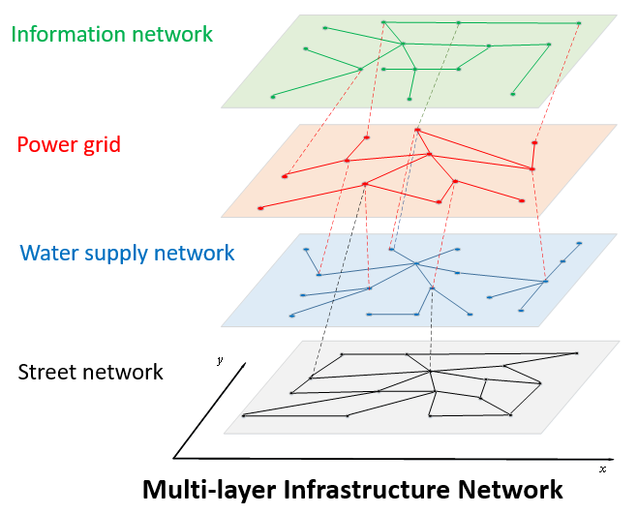
2|
Research Objective and Plan
Introduction
Project task 6
Tool for mapping resilience of urban regions across Canada for all hazards
Dr. Kong’s completed work
Collaboration with the City of Toronto
Notes:
For Prof Simonovic

Slide 3
3|
Research Objective and Plan
Risk to Resilience
Problem:
Different costs arising from disasters of similar magnitude and duration
Objective:
Use quantification of resilience combined with network theory
Translating theoretical work to practical use
Notes:
Previously, we were puzzled that despite natural disasters of similar magnitude and duration, they can end up with considerably different costs. The research undertaken tries to address this issue with the concepts of network theory combined with the resilience concept. Previously, we saw that while risk and vulnerably can be useful in characterizing the potential damage of infrastructure, it is insufficient due to the increasing complexity infrastructure connections. Here, we build off of the work that Professor Simonovic has completed in the quantification of resilience and expand Jingjing’s model.
Why different insurance costs? Resilience! Not Risk and Vulnerability. Expand Prof and Jingjing work

Slide 4
4|
From Theory to Practice
Dr. Kong’s Theoretical Work
Notes:
Jingjing’s model previously used network theory to capture the interdependent nature of infrastructure. Beginning with one network layer, she showed the various types of dependencies that nodes and edges can share. She then considered the same phenomenon could occur for multiple types of infrastructures. Afterwards, it can be demonstrated that one layer’s service could affect the functionality of another layer’s, for an example, the requirements of electricity to pump water throughout a city.

Slide 5
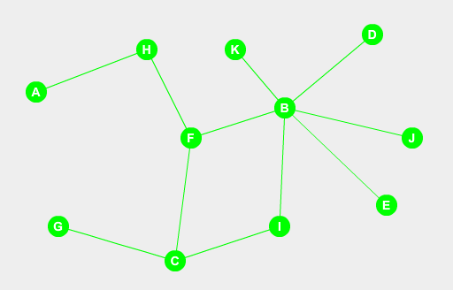
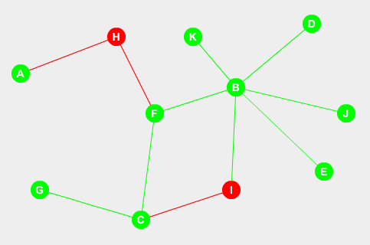
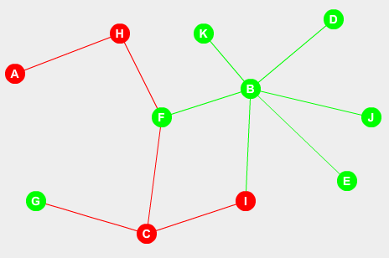
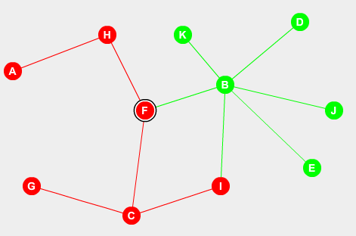
5|
From Theory to Practice
Dr. Kong’s Theoretical Work
1
2
3
4
Functional
Non-Functional
Notes:
The model considered a simple natural disaster that reduced the functionality of a certain sets of nodes and edges from various network layers. At each time interval, additional nodes and edges functionality can be lost due to the dependent connections that existed. Although a single node or edge’s dependency may be captured one level up, it becomes increasingly difficult to consider the dependencies multiple levels above it and repeating the process for other nodes.

Slide 6
6|
From Theory to Practice
Needs and Goal
Needs:
The quantification of resilience in applied networks
A model to capture nodal dependencies and interdependencies
Evolve the theoretical concepts into…
A Practical Decision Making Support Tool!
Notes:
Various recovery strategies were introduced that based on literature and each had different effects on the overall system recovery of the natural disaster scenario.
While the model has potential from a theoretical perspective, it cannot be applied directly as a decision making support tool. This brings us back to the research that myself, Andre and Professor Simonovic are now involved in – specifically the generalization of the tool to make it usable from an insurance/infrastructure perspective.

Slide 7
7|
Decision Support Methodology
Key Steps
    Step 1. Network development
    Step 2. Disaster propagation/restoration strategies
    Step 3. Resilience calculation
    Step 4. Decision making (multi-objective analysis)
Notes:
In terms of accomplishing this, we plan to break it down into 4 steps. The first is to build a realistic network. Once the network building is complete, then a simulation can run, demonstrating how failure propagates through the network and the implementation of various restoration strategies. The third step is the calculation of resilience value which is dynamic in nature. The final step is using the resilience value to help with decision support.
The next part of the presentation will explore each of the steps in greater detail. This includes what we are doing along with a general direction of the step. Near the end, Andre will talk about the computational side of the things such as the user interface.

Slide 8
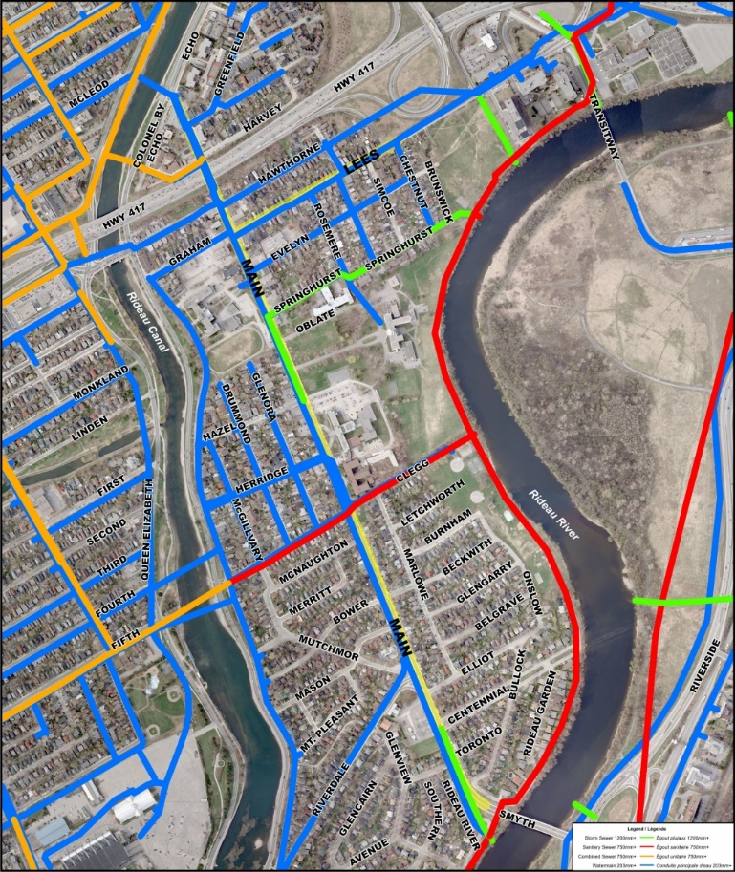
8|
STEP 1: NETWORK DEVELOPMENT
Options
Options for Network Development
Use of an existing network
Modifying an existing network
New network development
Notes:
When building a network, Professor Simonovic has suggested we capture the 3 main scenarios that a network is built in the program. The first is building the network from scratch using user inputs. This can range from free hand to data input from excel files or perhaps GIS shapefiles. The second option would be to modify an existing network. The modifications may be adding or removing nodes or edges from the system. The third option would be to simulate a network with minimal input from the user. The option may become relevant for construction of a new area or perhaps an emergency management scenario where they have to set up an impromptu water supply network.
Recently, I have been learning about network systems, as it is new to me along with looking into the algorithms that can be used to simulate network growth. I will share some of the network properties, particularly those relevant to network building and then go into some of the models that I have read about.

Slide 9
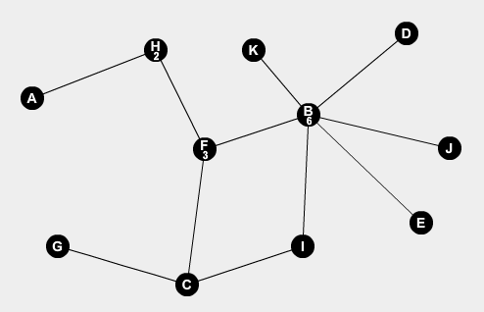
9|
STEP 1: NETWORK DEVELOPMENT
Network Theory – Degree Distribution
Notes:
We begin with the term degree which means the number of the edges linked to any one node. So node H on the figure has a degree of 2, node F has a degree of 3 and node B has a degree of 6. If we repeated this process of determining all of the degrees for each of the nodes of the network layer, we can determine the network edge distribution. The network edge distribution is a characteristic of the network that reflects the standard deviation of the degrees. You can kind of associate with income equity or inequality as an analogy.

Slide 10
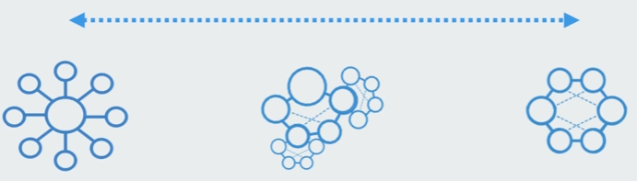
10|
STEP 1: NETWORK DEVELOPMENT
Network Theory – Degree Distribution
Centralized Decentralized Distributed
Think Academy, "Network Degree Distribution," in Complexity Academy, January 6, 2016, http://complexityacademy.io/degree-distribution/
Notes:
Looking at the next slide, you can see the difference between the two extremes. On the right, you see uniform distribution where each node has exactly 3 links. On the left, you can see all nodes having one edge that links to the center. The center node has many links to it. In reality, networks are somewhere between the two extremes. When focusing on infrastructure, they tend to lean closer towards the left side, showing a scale-free, centralized nature. These networks emerge as a result of the environmental constraints. For an example, consider airplane transportation routes. It would not be viable and feasible for each airport to allow travel to all the other airports around the world due to space constraint and demand at any given time. This constraint forces airports to be located in certain areas along with the number routes that are available. Although, air travel was used in the example, this principle holds true for other infrastructure as well such as the electricity grid and cost (be it initial or maintenance) for increasing links. Just to be clear, cost is not always the reason for the formation of scale free nature. Internet networks have that characteristic due to many sites linking to popular sites, google for an example.

Slide 11
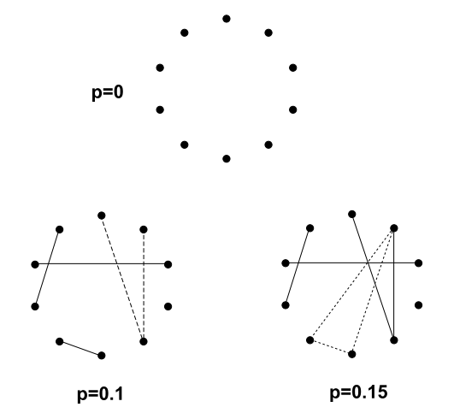
11|
STEP 1: NETWORK DEVELOPMENT
Network Theory - Erdos Renyi Model
p = probability of connection
between any 2 nodes
Source: Albert and Barabossi (2002)
Notes:
This characteristic ties into the some of the models we will be going through including the Eros Renyi model, Callaway Model and Price’s model.
The Erdos Renyi model creates a network by first obtaining an input regarding the number of nodes to begin with and a probability P of connection. Once that is established, the edges are then added randomly. It is one of the oldest models and has historically been used before the popularity of network theory. This type of network creates a Poisson type of edge distribution.

Slide 12
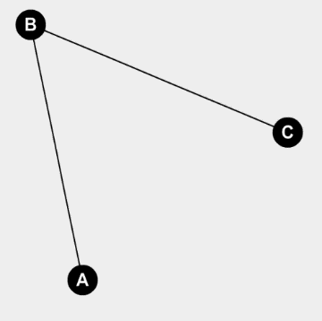
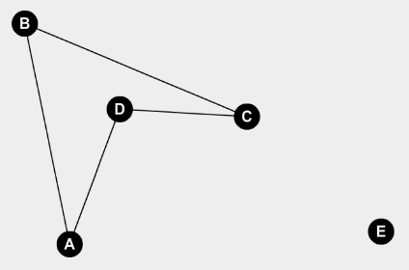
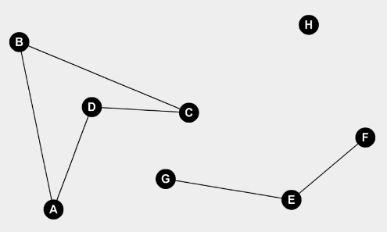
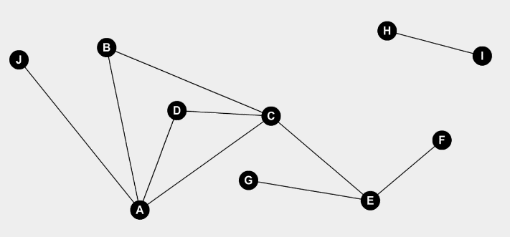
12|
STEP 1: NETWORK DEVELOPMENT
Network Theory - Callaway Model
t=0
t=2
t=5
t=7
Notes:
I found this model through literature review. The model was originally used to capture the network growth of internet websites. The issue that many models have is that the edges are added alongside the node it came with. Thus, it creates a connected network all the times. In website connections, not all websites are connected to each other. I mean that they can be in separate components entirely. Yet, in the near or distant future, there is a chance that they can be connected and a pathway could form. Before then, it is entirely possible both separate components can grow or stagnate independently.
This model solves this issue by creating an algorithm that inserts nodes and then the edges are inserted at random somewhere between any two nodes in the existing network. By doing so, the older nodes have a tendency to have more edges than younger nodes. In terms of degree distribution, this creates an exponential relationship type distribution – which is close but not the same as scale free networks.

Slide 13
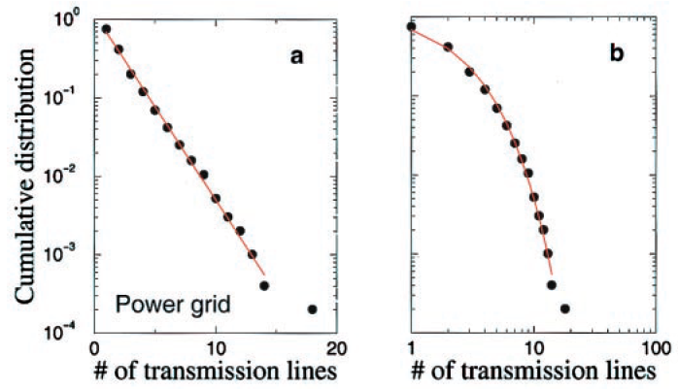
13|
STEP 1: NETWORK DEVELOPMENT
Network Theory - Callaway Model
Source: Amaral et al. (2000)
Notes:
In another piece of literature, it was shown that the electrical network in Southern California had this of degree distribution. As the Callaway model creates a model with a similar key property of key infrastructure, it can be assumed that the model is a closer fit than Random network model and even a model that creates a scale-free characteristic.

Slide 14
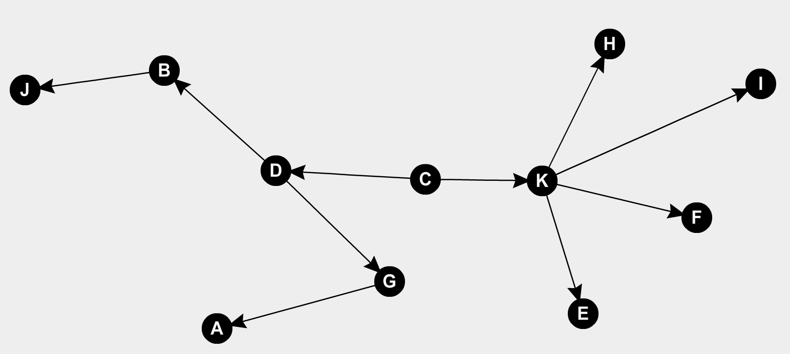
14|
STEP 1: NETWORK DEVELOPMENT
Network Theory - Price Model
Adding Direction to Network
Notes:
This is a very old model, but it does capture an important property of the infrastructure network of interests. The property that it captures is the undirected vs direct nature of edges. Previously, and in the models before, it was assumed that edges were a two way connection such that flow could occur from either side. If this is true for the entire network, it is termed as a undirected graph or network. However, in some infrastructures such as water pipe networks, the flow does have a direction and needs to be captured in the model. These networks are termed as directed graphs or networks.
Price’s model does have directed property. The original network of interest to Price’s model was the citation networks of scientific papers. In the study, it showed that an edge going to a node represented the in-degree; the physical meaning being it was cited by another paper. The edges leaving a network represented a journal paper citing another paper and is termed out-degree. Adding a directed characteristic into network models does make a significantly more complex as I am finding out first hand when understanding the algorithms. I am currently still in the progress of learning this one.

Slide 15
15|
STEP 2: FAILURE PROPAGATION AND RECOVERY
Disaster Propagation and Custom Recovery Options
Specification of Recovery Strategies
  RS-FF: First repair the elements first failure (intra-network)
  RS-FL: First repair the elements last failure (intra-network)
  RS-IE: First repair the important elements independently (intra-network)
  RS-ED: First repair the obvious dependent elements (inter-network)
  RS-EP: First repair the latent dependent elements (inter-network)
Development of computerized code for providing recovery options
Notes:
Moving on, we have the second step of the plan. This step entails running a disaster scenario and comparing recovery strategies. The user input is still to be determined at this point. Jingjing’s current code requires specific input on the edges and nodes to be removed initially. It also required direct input on which nodes and edges would be recovered at each time step.
Similarly, in the tool we expect to allow the users to input the nodes and edges that would be originally affected. We would then let the code perform its algorithm and determine which additional nodes/edges would be affected at future timesteps. The same principle would apply to the 5 recovery strategies that Jingjing had identified. Examples include repairing the first items that lost its function, repairing the most optimized method for a specific network layer, and repairing the most optimized way when looking at the overall infrastructure network layers. Regarding the recovery strategies, we plan to explore further strategies along with allowing users to create their own recovery strategies as well.

Slide 16
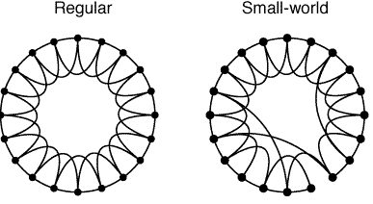
16|
STEP 2: FAILURE PROPAGATION AND RECOVERY
Theory – Small World Phenomenon
Source: Watts and Strogatz (1998)
Same number of nodes and edges, but smaller average path length
Notes:
At this point of the presentation, I want to introduce the concept of the Small World Phenomenon as it relates to network theory. The Small World Phenomenon is an observation that nodes have a smaller average pathway between any two than expected. Consider the following 2 diagrams. Both of these have the same number of nodes and edges. The one on the left has a uniform distribution and while the one on the right has a few connections rewired. However, there is a difference in their average path length. The average path length is network property. A path is defined as the shortest distance between any two nodes. If you repeated this process for all nodal combinations in the network and calculate the average, that would get you the average path length. Just looking at the picture on the left, you can see it would take awhile for one node to reach a node on the opposite side. However, by rewiring a few edges, shortcuts can emerge, hence allowing travel in shorter amount of steps.

Slide 17
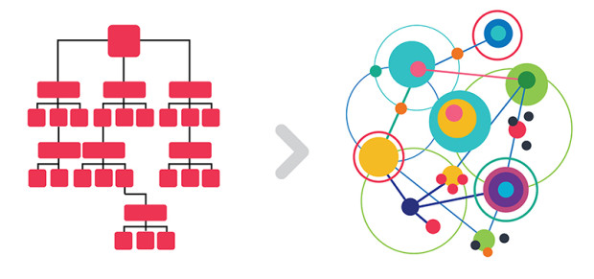
17|
STEP 2: FAILURE PROPAGATION AND RECOVERY
Faster Propagation and Recommendations to Redesign Networks
Source: https://thenatureofbusiness.org/page/3/ and
http://humanspaces.com/2016/08/29/the-future-of-business-redesigning-for-resilience/
Notes:
This concept is relevant to failure propagation and recovery design. Many real life networks, including infrastructure networks have this small-world property because of its benefits in efficiency and dealing with environmental constraints, such as financial or space constraints. However, this makes it easy for failure to cascade throughout the network. A conceptual analogy can be made with the spread of diseases where sickness can be transferred from one person to the next given their proximity. We have seen this occur during the blackout of 2003 in Ontario and the northeastern part of the US.
However, the opposite effect can also be true. Similar to the disease example, if you were to immunize the population, even a certain amount of the population, the spread of diseases declines. This brings us to one of the features we hope this tool may provide on top of comparing the resiliency of recovery strategies, which include suggestions to remodel the network structure to make it more resilient. As an adage goes, what does not help a system can harm the system. The placement of a specific node or edge can make the system less resilient, which we aim to identify and suggests alternative designs.

Slide 18
18|
STEP 3: Resilience Calculation
Resilience
Redundancy
Notes:
This step is dedicated to the calculation of resilience. Much of the calculations are expected to remain same. This includes treating the resilience value as the area under the curve and allowing the value to update dynamically through the time-steps. Some adjustments may be required when implementing this in real life.

Slide 19
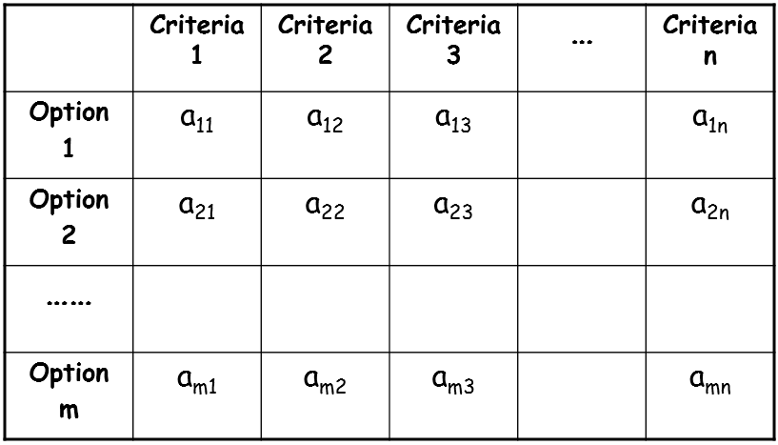
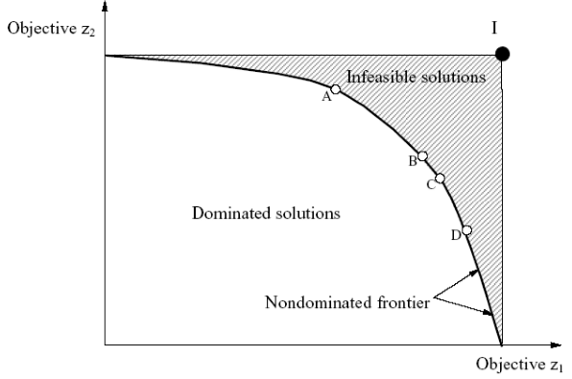
19|
STEP 4: Decision Making Support
Multi-objective Analysis
Source: Simonovic, Course Notes: MO4
Notes:
The final step encompasses creating function within the tool to perform multi-objective analysis, where one of the objectives would be to maximize the resilience in the system. Another objective might be to minimize the cost. As with any multi-optimization problem, the ideal solution is typically located in the infeasible region. However, one can obtain a solution set that is non-dominated, that is a solution set where no improvements can occur without giving up value from another objective. At that point, one can obtain a best compromise solution if given the preferences from the user.
I will now pass it on to Andre to inform you of the tool’s features and how the tool can be developed.

Slide 20
20|
WEB BASED DECISION SUPPORT TOOL
  New resilience tool
    Decision support system (DSS) structure
    Key features of the new tool
      Sliders, maps, graphs
      Databases, web interface choice
  User walkthrough of tool
    Step 1. Building network
    Step 2. Disaster propagation/Restoration strategies
    Step 3. Resilience calculation
    Step 4. Decision making (Multi-objective analysis)
  ResilSIM tool prototype

Slide 21

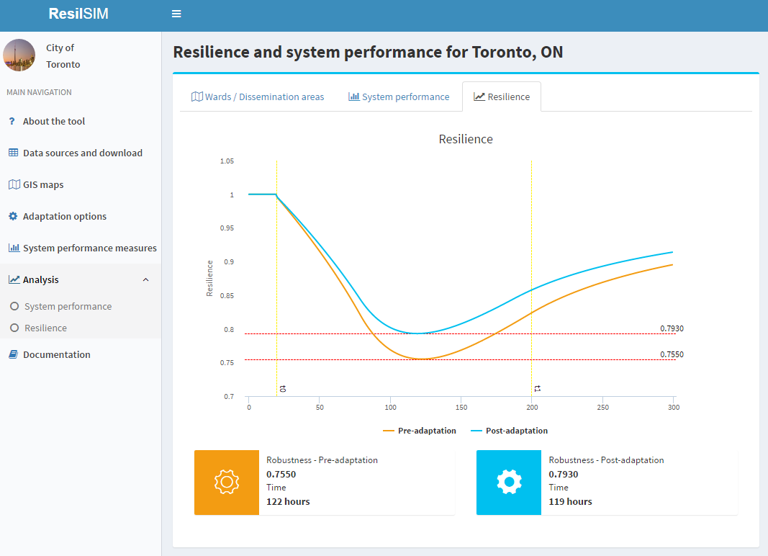

21|
WEB BASED DECISION SUPPORT TOOL
  Structure and key features of the tool
  Decision support system (DSS)
Mathematical Models
User Interface
Database

Slide 22
22|
WEB BASED DECISION SUPPORT TOOL
  Key features of the tool
    Web base user interface
    GIS web base mapping plugin for creating and modifying the network
    User inputs: sliders and user-friendly data input controls
    Outputs: interactive graphs, color maps
  Technologies
    Database: PostgreSQL + PostGIS (GIS extension)
    User Interface: HTML5 + JS Framework + CSS + Asp.Net (Server side)
    Model base: Network Algorithms + Resilience calculation
Notes:
User inputs: (i.e. number nodes and edges, of time steps for simulation, recovery strategies, networks building options, etc.)

Slide 23
23|
WEB BASED DECISION SUPPORT TOOL
User’s perspective and
interaction with the tool
Model base and algorithms
applied on each step
Step 1: Network development
  Import from existing (shapefile)
  Create & modify (inputs on the map)
Models for creating and growing networks
Step 2: Disaster & Recovery
  Disaster type (user input)*
  Pre-defined strategies (lists of options)
  User defined strategies
Disaster propagation, from a given user input and recovery strategies algorithms
Step 3: System performance and
resilience calculation
System performance & resilience calculation using network theory
Step 4: Decision Making
  Multi-objective analysis
  User drive preferences
Compromise programming and tool automation to extract trade-off solutions.
Notes:
Step 1. Building network:
Create networks by drawing nodes on the map
Import a pre-existing network (GeoJSON files or shapefiles format)
Network Creation
Network Expansion
Simulate network creation
Step 2. Disaster Propagation/Restoration Strategies:
Predefined strategies and user defined (freely from the UI)
Step 3. Resilience Calculation
Model base/algorithms
Step 4. Decision making (Multi-objective)
Multi-objective analysis with optimization and interactive network Resilience

Slide 24
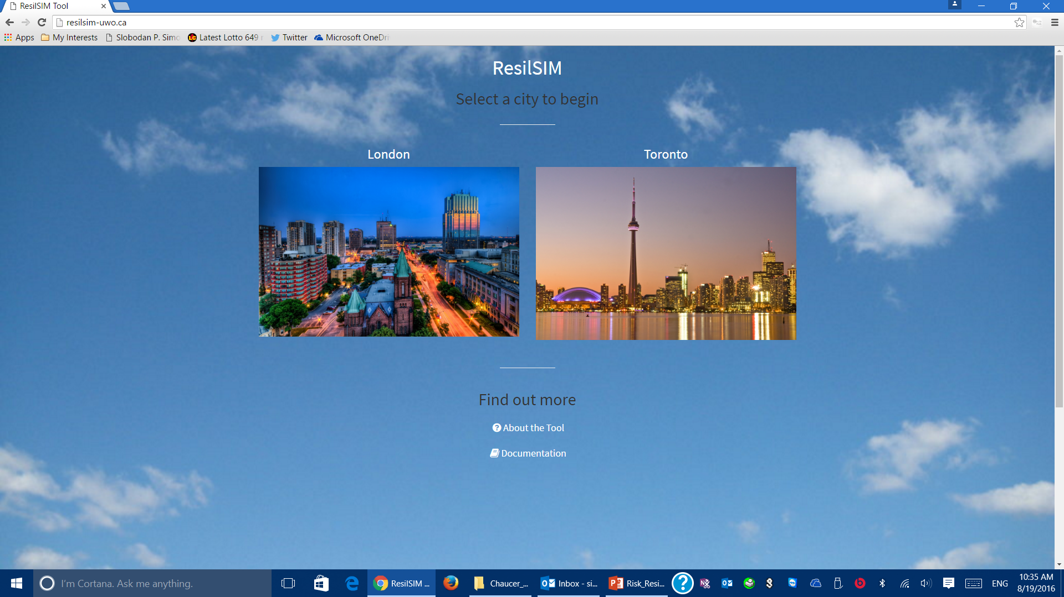
24|
WEB BASED DECISION SUPPORT TOOL
ResilSIM Prototype

Slide 25
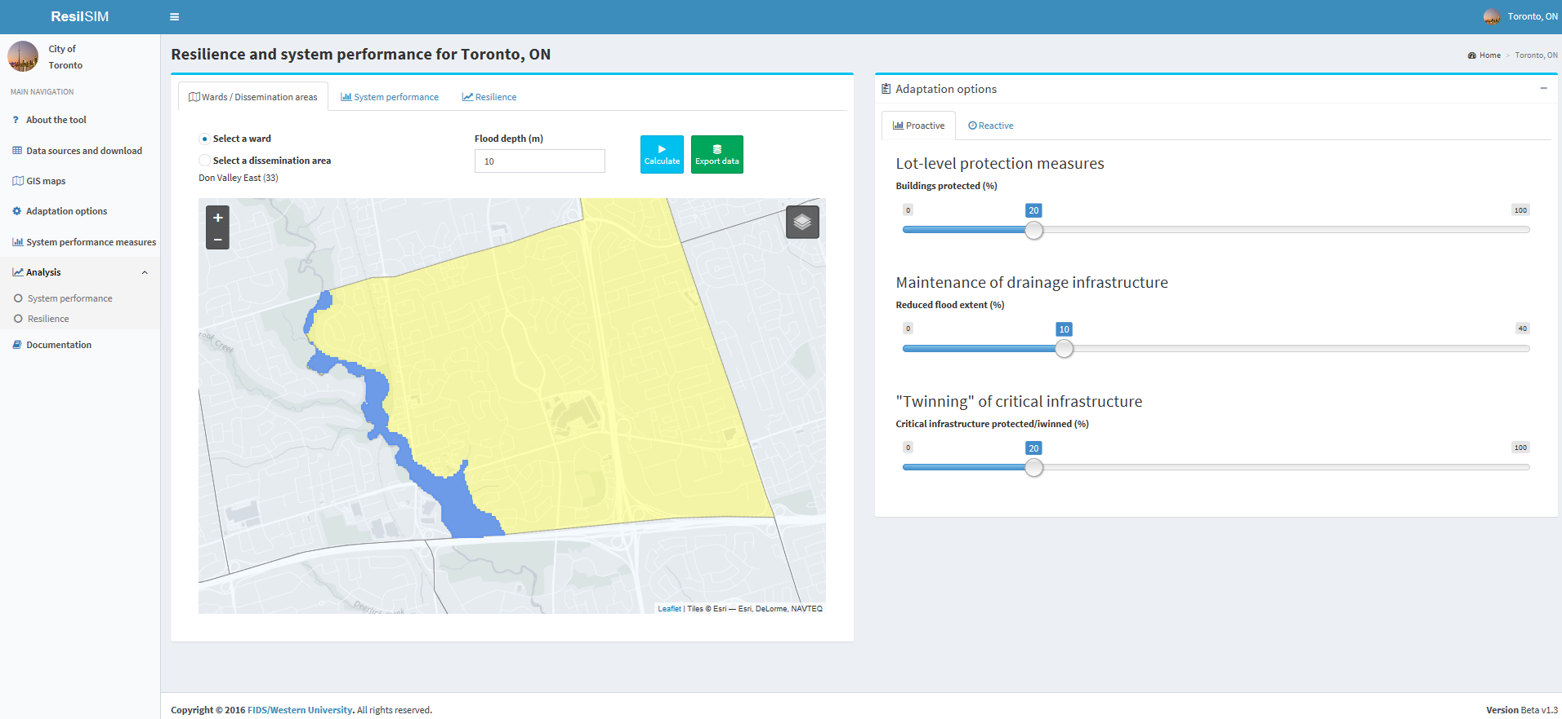
25|
WEB BASED DECISION SUPPORT TOOL
ResilSIM Prototype

Slide 26
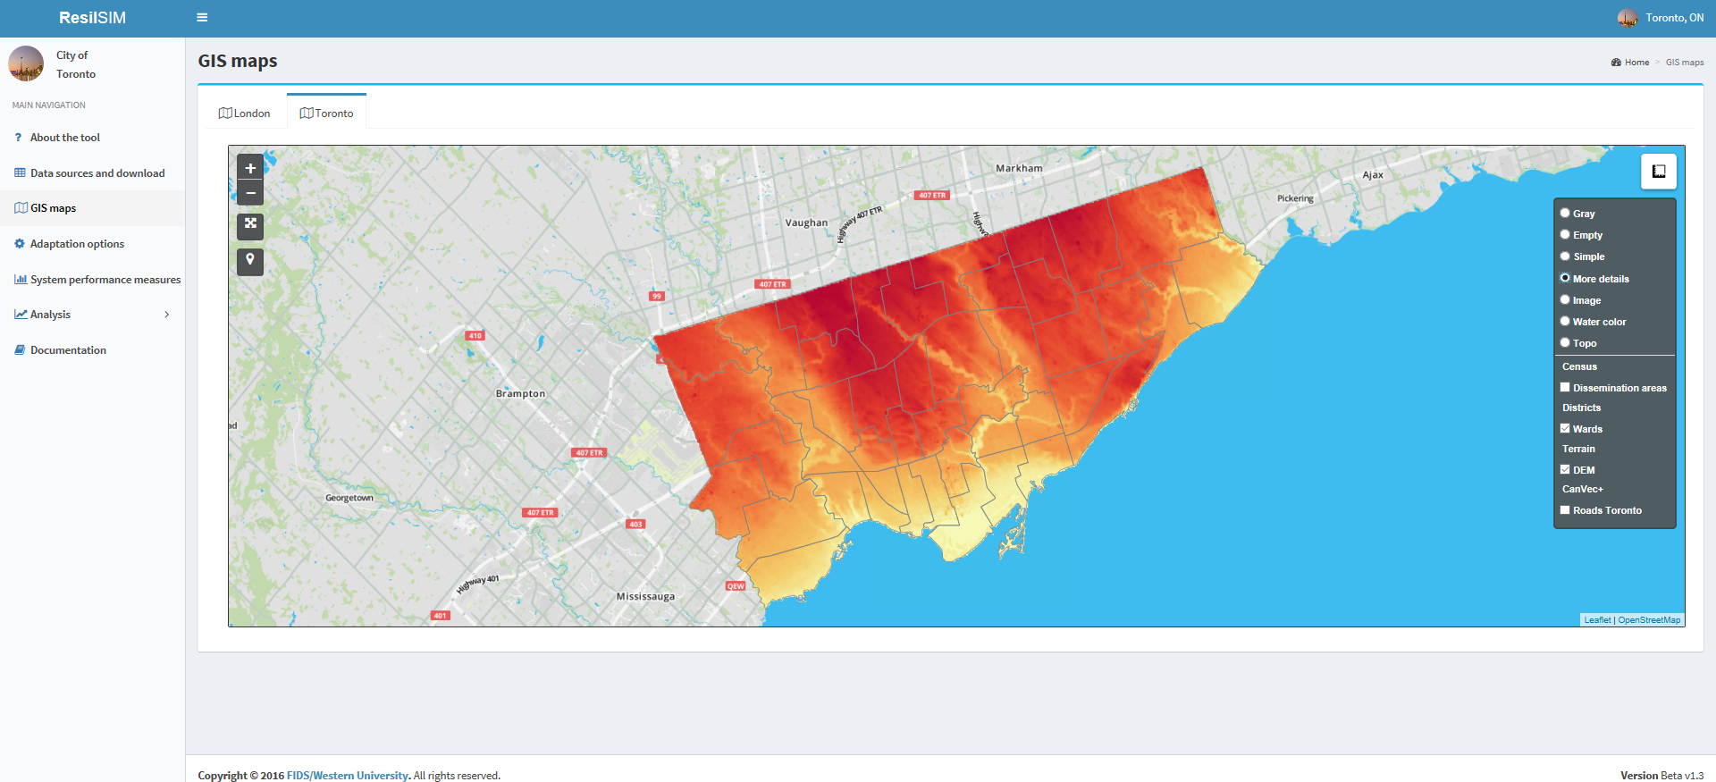
26|
WEB BASED DECISION SUPPORT TOOL
ResilSIM Prototype

Slide 27
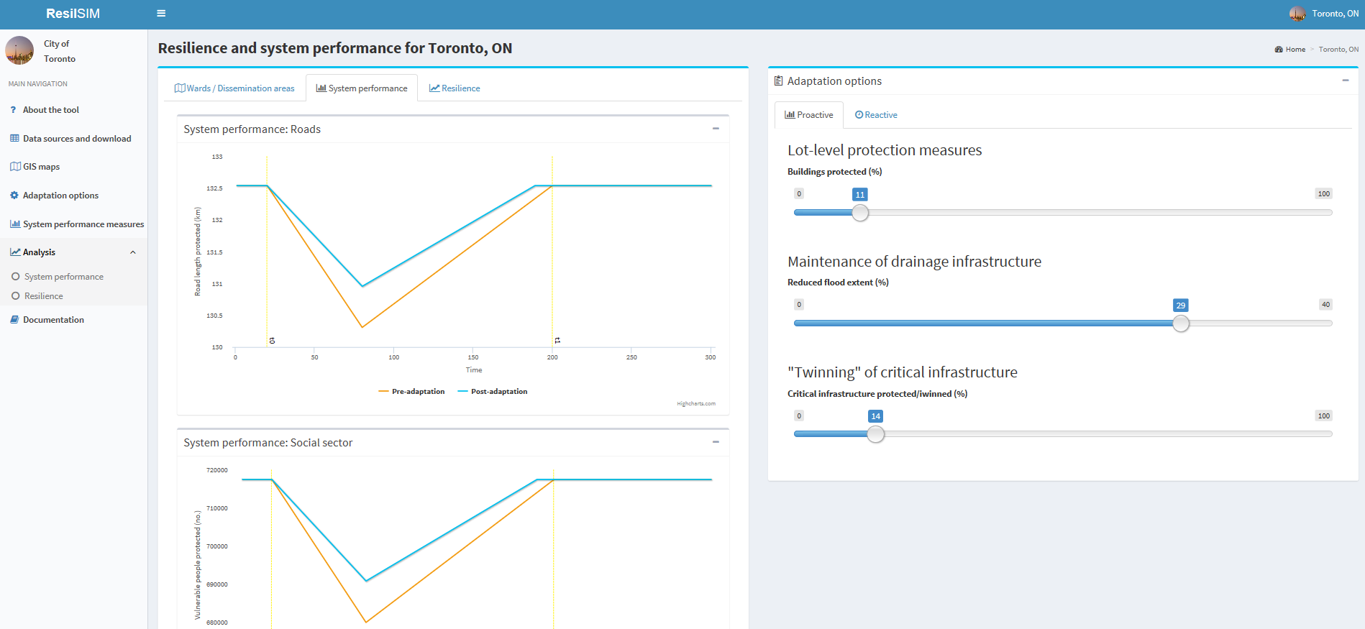
27|
WEB BASED DECISION SUPPORT TOOL
ResilSIM Prototype

Slide 28
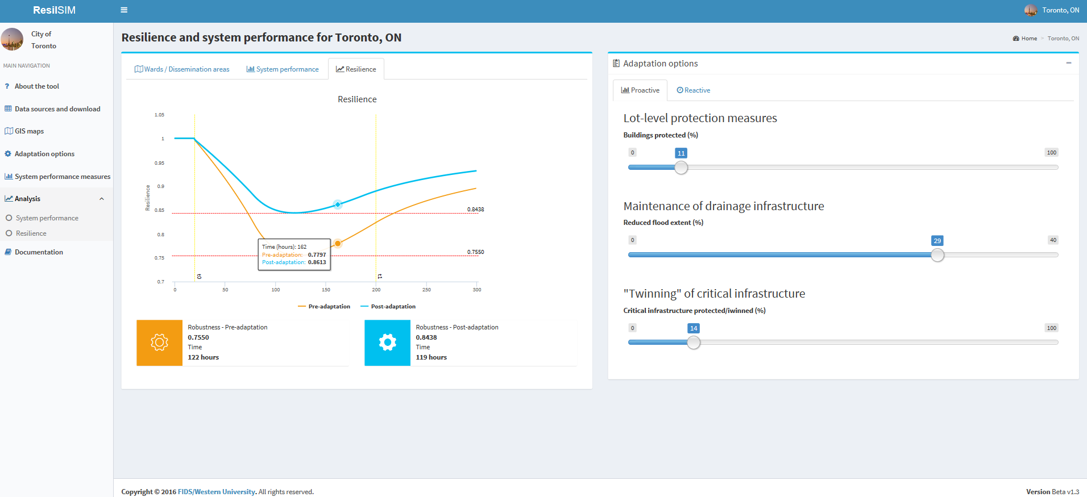
28|
WEB BASED DECISION SUPPORT TOOL
ResilSIM Prototype

Slide 29
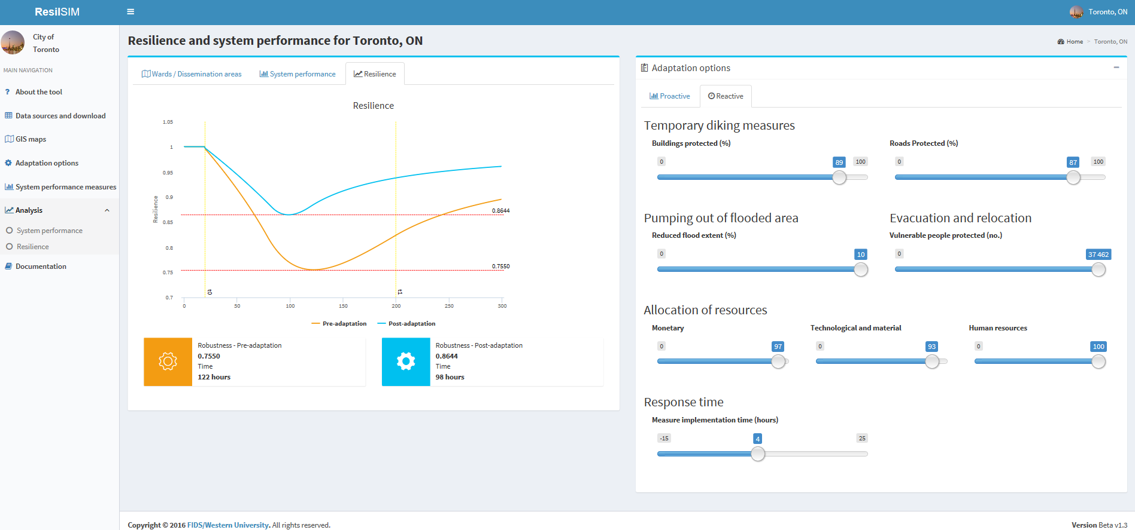
29|
WEB BASED DECISION SUPPORT TOOL
ResilSIM Prototype

Slide 30
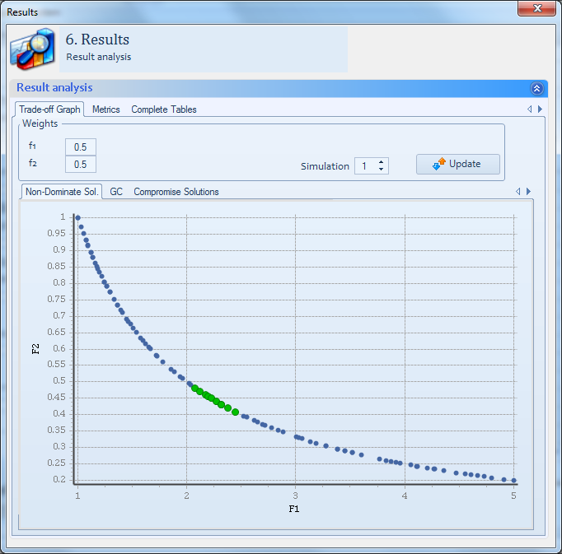
30|
WEB BASED DECISION SUPPORT TOOL
    Step 4: Multi-objective analysis using Compromise Programming: preferences or weights provided will identify “best compromise solutions.”

Slide 31
31|
CONCLUSIONS
Where we are and next steps
Developed a 4 – step plan to create a practical tool that is usable for insurance, municipalities and infrastructure owners
In progress of understanding the theory and algorithms to build and expand networks
Planning out the types of software required and user interface
Communicating with the City of Toronto to understand their needs and reach an agreement on data requirements
Notes:
In conclusion, to meet the objective of developing a practical tool from a theoretical basis, we have laid out 4 key steps of the model development. These steps are expected to generalize and adapt the theoretical model to a tool that is usable in the hands of you all and infrastructure stakeholders. Currently, we are in the midst of learning about network development through models and their associated algorithms.
We are also planning out the necessary software required and determining the key features of the tool. We are also in communication with the City of Toronto personnel to learn more about their needs, real data that could be useful and how the tool can help fulfill it.

