Slide 1

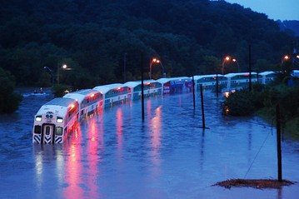
CHANGE IN FLOOD RISK PATTERN ACROSS CANADA UNDER CHANGING CLIMATE
Ayushi Gaur (MESc. Student)
Abhishek Gaur (Post-doctoral fellow)
Supervised by-
Professor Slobodan P. Simonović

Slide 2
Work progress
2|
Research Objective
To analyze changes in flow risk patterns across Canada under changing climate scenario.
Work completed
Literature Review
Model selection
Data collection
CamaFlood model validation
CamaFlood model performance across Canada
Future flow projection for CanESM2, RCP4.5
Flood frequency analysis (100 year and 250 year)
Change in Flood Risk across Canada under Changing Climate
Ayushi Gaur, Abhishek Gaur, Professor Slobodan P. Simonović

Slide 3
Methodology
3|
Low resolution future runoff projection
GCM based
Flood Risk Analysis
Low resolution (2°-5°)
Energy balance
Land surface schemes
Macro-scale hydrodynamic model
High resolution flow projection
CamaFlood (Catchment-Based hydrodynamic model)
Sub-grid topographic parameters
10-25km resolution
Overlapping Hazard with the exposure
Population overlapping with the runoff projections
High resolution flow
SHARCNET
Change in Flood Risk across Canada under Changing Climate
Ayushi Gaur, Abhishek Gaur, Professor Slobodan P. Simonović

Slide 4
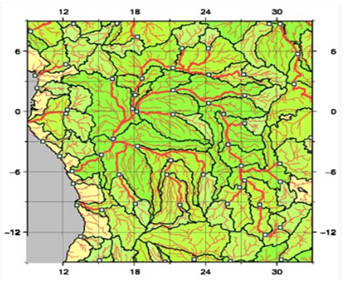
4|
CamaFlood
Grid –based river and floodplain routing calculations
Runoff forcing from land surface schemes within GCMs used as input
Flow calculation in each grid specific unit-catchment
Water storage is the only prognostic variable, other variables are derived empirically
Up-scaled river network map is prepared using Flexible Location of Waterways ( FLOW ) method
Change in Flood Risk across Canada under Changing Climate
Ayushi Gaur, Abhishek Gaur, Professor Slobodan P. Simonović
Notes:
CamaFlood is a grid based river and floodplain routing model that performs the calculation of flow for each grid specific unit catchment.
A unit catchment area is the total area that is contributing to the outflow from each grid, this flow performs the water balance calculations and then routed along the up-scaled river network map.
We take the low resolution runoff as input from the land surface schemes within the GCMs.
Camaflood calculates the total water storage (river channel water storage +floodplain water storage) at each grid and other variables like-river& floodplain discharge, flood area, total discharge, water surface elevation , river &floodplain water depth etc are derived empirically.
CamaFlood takes the input of coarse resolution river network map, which is prepared using unique upscaling method which is named as flexible location of waterways method.

Slide 5
5|
Work completed since last progress meeting
Continuous daily simulation of historical (1961-2016) and future flow projections (2017-2100) across Canada
Input daily flow data obtained from 23 Global Climate Models taking all available emission scenarios
Change in 100 year and 250 year return period flood magnitude estimated
Flood frequency analysis is performed by fitting the annual maximum flows using Generalized extreme value (GEV) distribution
Scale, shape and location parameters estimated using method of moments
11 out of 23 GCMs flood frequency analysis is done using SHARCNET
Change in Flood Risk across Canada under Changing Climate
Ayushi Gaur, Abhishek Gaur, Professor Slobodan P. Simonović

Slide 6
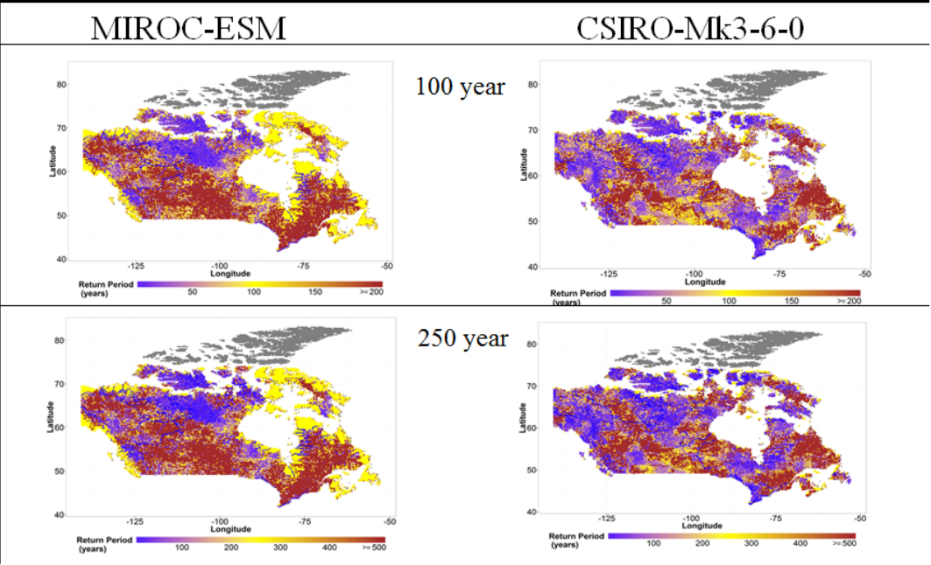
Return period change of historical flood event
6|
RCP2.6
Change in Flood Risk across Canada under Changing Climate
Ayushi Gaur, Abhishek Gaur, Professor Slobodan P. Simonović

Slide 7
Return period change of historical flood event
7|
RCP4.5
Change in Flood Risk across Canada under Changing Climate
Ayushi Gaur, Abhishek Gaur, Professor Slobodan P. Simonović

Slide 8
Return period change of historical flood event
8|
RCP6.0
Change in Flood Risk across Canada under Changing Climate
Ayushi Gaur, Abhishek Gaur, Professor Slobodan P. Simonović

Slide 9
Return period change of historical flood event
9|
RCP8.5
Change in Flood Risk across Canada under Changing Climate
Ayushi Gaur, Abhishek Gaur, Professor Slobodan P. Simonović

Slide 10
Conclusions
10|
CamaFlood is a state-of-the-art hydrodynamic model that can be used to perform flood risk assessment across Canada
Model validation over historical period shows promising results
Model performance is found sensitive to parameters and location of analysis
Changes in flood frequency as projected by different GCMs and RCPs are found to be considerably different from one another
Future flood hazard varies significantly over different regions of Canada
Change in Flood Risk across Canada under Changing Climate
Ayushi Gaur, Abhishek Gaur, Professor Slobodan P. Simonović

Slide 11
11|
Conclusions
Uncertainty sources:
  Selection of Global Climate Models
  Selection of carbon emission scenarios
Flood frequency is different for different GCMs and RCPs
Most of the GCMs are showing increase in flood frequency and decrease in return period in the areas:
  Northern Canada - Yukon, Nunavut, Northwest Territories;
  Western Canada - British Columbia, Alberta
  South Ontario
Change in Flood Risk across Canada under Changing Climate
Ayushi Gaur, Abhishek Gaur, Professor Slobodan P. Simonović

Slide 12
Interpretation and future work
12|
Downscale and analyse runoff projections for rest of the GCMs.
Projected changes can be linked to climatic factors such as: precipitation and temperature change, to explain differences in projections from different GCMs.
Need to find a way to combine the results from multiple GCMs to ascertain spatial distribution of flood hazard.
Compare flow projections obtained from GCMs with CamaFlood derived projections.
What fraction of flood hazard translates to flood risk?
Change in Flood Risk across Canada under Changing Climate
Ayushi Gaur, Abhishek Gaur, Professor Slobodan P. Simonović

Slide 13
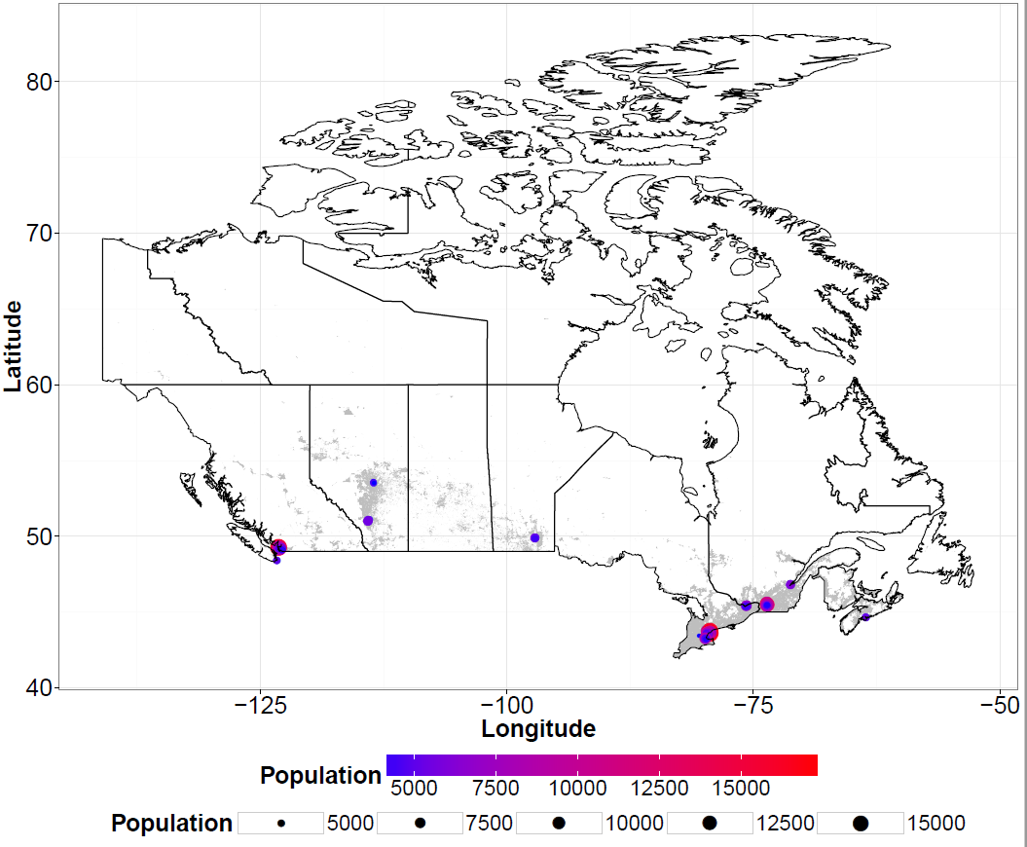
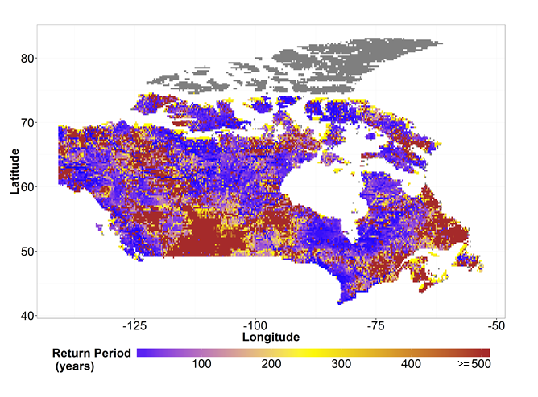
Interpretation and future work
13|
Flood Risk = Flood hazard * Exposure(Population)
Change in Flood Risk across Canada under Changing Climate
Ayushi Gaur, Abhishek Gaur, Professor Slobodan P. Simonović

Slide 14
References
14|
Doxsey-Whitfield, E., K. MacManus, S.B. Adamo, L. Pistolesi, J. Squires, O. Borkovska and S.R. Baptista. 2015. Taking Advantage of the Improved Availability of Census Data: A First Look at the Gridded Population of the World, Version 4. Papers in Applied Geography 1(3): 1-9. http://dx.doi.org/10.1080/23754931.2015.1014272
Yamazaki, D., (2014). The global hydrodynamic model CaMa-Flood (version 3.6.2), Japan Agency for Marine-Earth Science and Technology, retrieved from website: http://hydro.iis.u-tokyo.ac.jp/~yamadai/cama-flood/Manual_CaMa-Flood_v362.pdf
Yamazaki, D., Oki, T., and Kanae, S., 2009. Deriving a global river network map and its sub-grid topographic characteristics from a ﬁne-resolution ﬂow direction map. Hydrology and Earth System Sciences, 13, 2241–2251
Bates,P., Trigg,M., Neal, J., and Dabrowa,A., (2013). LISFLOOD-FP, User manual, School of Geographical Sciences, University of Bristol. University Road, Bristol, BS8 1SS, UK. Retrieved from website: http://www.bristol.ac.uk/media-library/sites/geography/migrated/documents/lisflood-manual-v5.9.6.pdf.
Hirabayashi, Y., Mahendran, R., Koirala, S., Konoshima, L., Yamazaki, D., Watanabe, S., … Kanae, S. (2013). Global flood risk under climate change. Nature Climate Change, 3(9), 816–821. doi:10.1038/nclimate1911.
IPCC, 2007: Climate Change 2007: The Physical Science Basis. Contribution of Working Group I to the Fourth Assessment Report of the Intergovernmental Panel on Climate Change [Solomon, S., D. Qin, M. Manning, Z. Chen, M. Marquis, K.B. Averyt, M. Tignor and H.L. Miller (eds.)]. Cambridge University Press, Cambridge, United Kingdom and New York, NY, USA, 996 pp.
Huber, M., & Knutti, R. (2011). Anthropogenic and natural warming inferred from changes in Earth’s energy balance. Nature Geoscience, 5(1), 31–36. doi:10.1038/ngeo1327.

Slide 15
Thank you!

