Slide 1
Earthquake Site Response of fraser river delta sediments for Cascadia mega-thrust events
Sheri Molnar (with Hadi ghofrani & Gail M. Atkinson)
University of Western Ontario, Canada

Slide 2
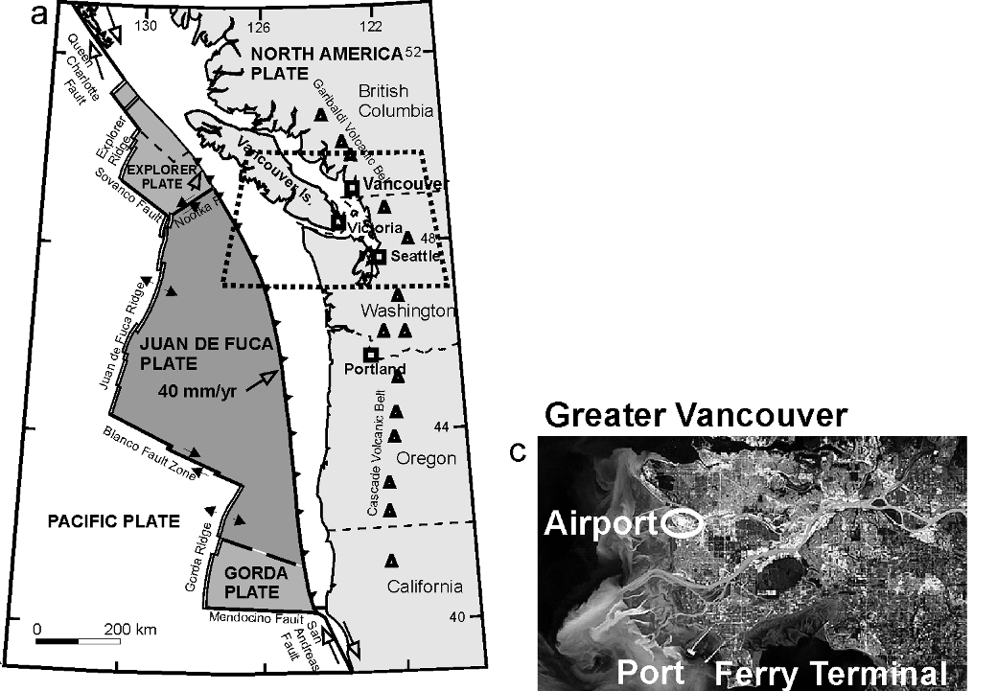
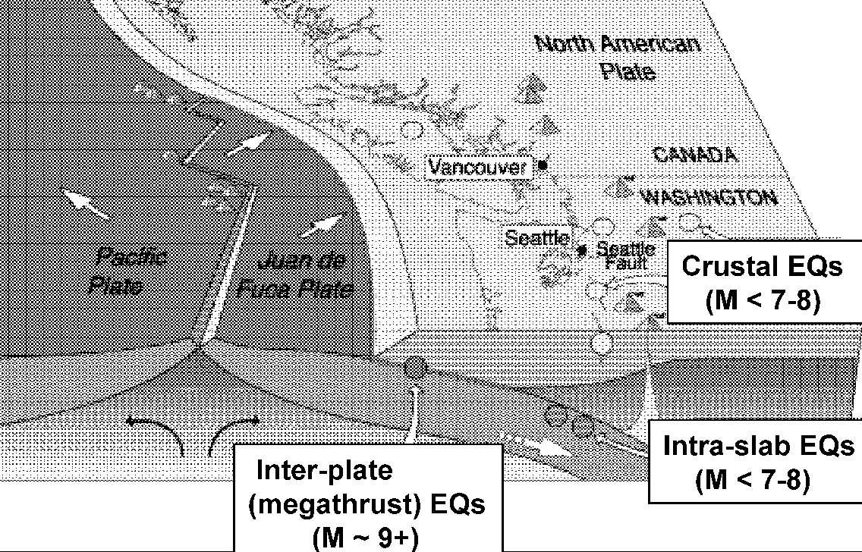
Greater Vancouver is area of highest seismic risk in Canada
Population > 2 million and critical infrastructure
Hazard
3 types of earthquakes
sedimentary basin
What will ground shaking be like during a future large earthquake?
Georgia basin

Slide 3
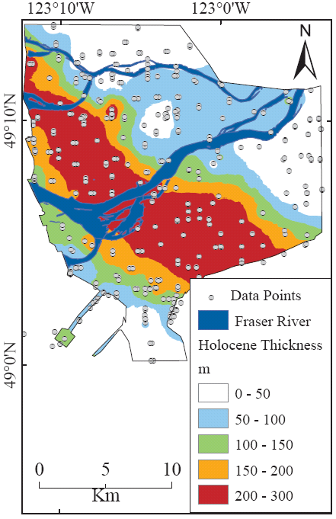
Fraser River Delta
Downhole logging
Seismic cone penetration testing [SCPT]
Surface reflection / refraction surveys
Hunter et al. (1998)
Up to ~300 m Holocene deltaic sediments
Up to ~600 m Pleistocene glacial sediments
Up to ~1 km depth to Tertiary clastic sedimentary bedrock

Slide 4
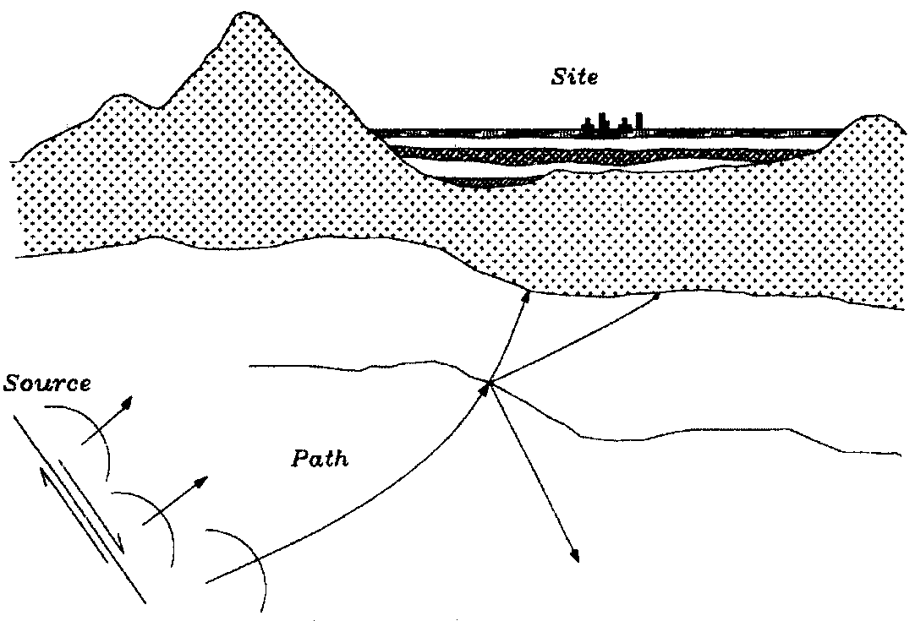
Earthquake Ground Shaking
Depends on:
Earthquake source (mechanism) and depth
Material properties along travel path
Site conditions
Ground surface shaking (amplitude, frequency and duration) is strongly affected by waves travelling through upper few kilometers (or less)
Earthquake damage related to “soft” soils (i.e. low shear-wave velocity material)
1964 Alaska, 1985 Mexico City, 1989 Loma Prieta, 1994 Northridge, 1995 Kobe
Soil profile
(1D structure)
Sedimentary basin (3D structure)

Slide 5
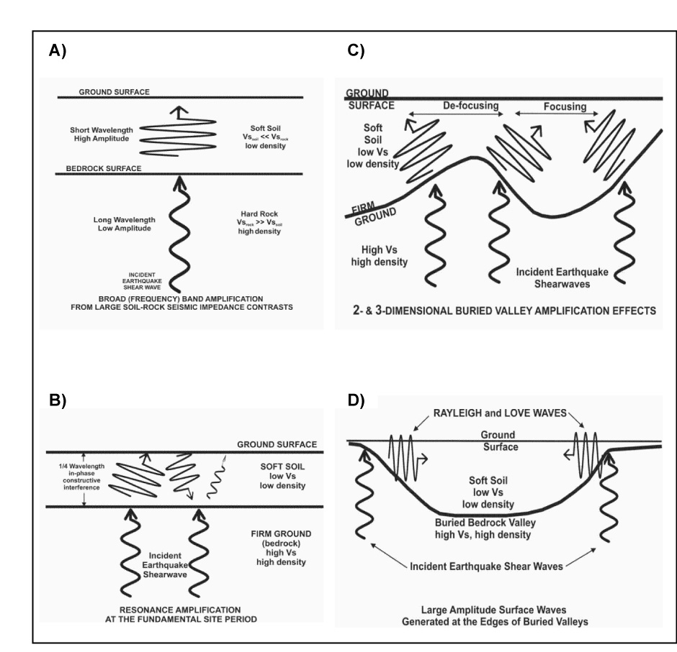
Ground Motion Amplification (e.g. soft soil overlying firm ground/bedrock)
1D impedance-based amplification
2D & 3D amplification effects
1D resonance-based amplification
2D & 3D edge effects

Slide 6
1-D site response
Site effect from vertically propagating shear waves depends on:
Soil layer thickness
Shear stiffness of soil (Vs or Gs)
Input motion
Impedance ratio
Soil damping
Natural frequencies of the system
Input frequencies
Damping

Slide 7
Modeling soil cyclic behaviour
FD Equivalent-linear method (e.g., Shake91)
TD Nonlinear method (e.g., Deepsoil)
Considerable differences (80%) between two methods are expected - differences in numerical (FD vs TD) methods, damping formulations, and implementation of nonlinear soil response behaviour (EQL vs fully NL)
TD-NL method is considered more appropriate for modeling soil nonlinear behaviour than FD-EQL (Tsai and Chen 2014)
All previous dynamic soil modeling behaviour of the Fraser River delta was accomplished using FD-EQL (Shake); Harris et al. (1998), Finn et al. (2003), Uthayakumar & Naesgaard (2004).
We select to perform TD-NL soil analysis for the Fraser River delta

Slide 8
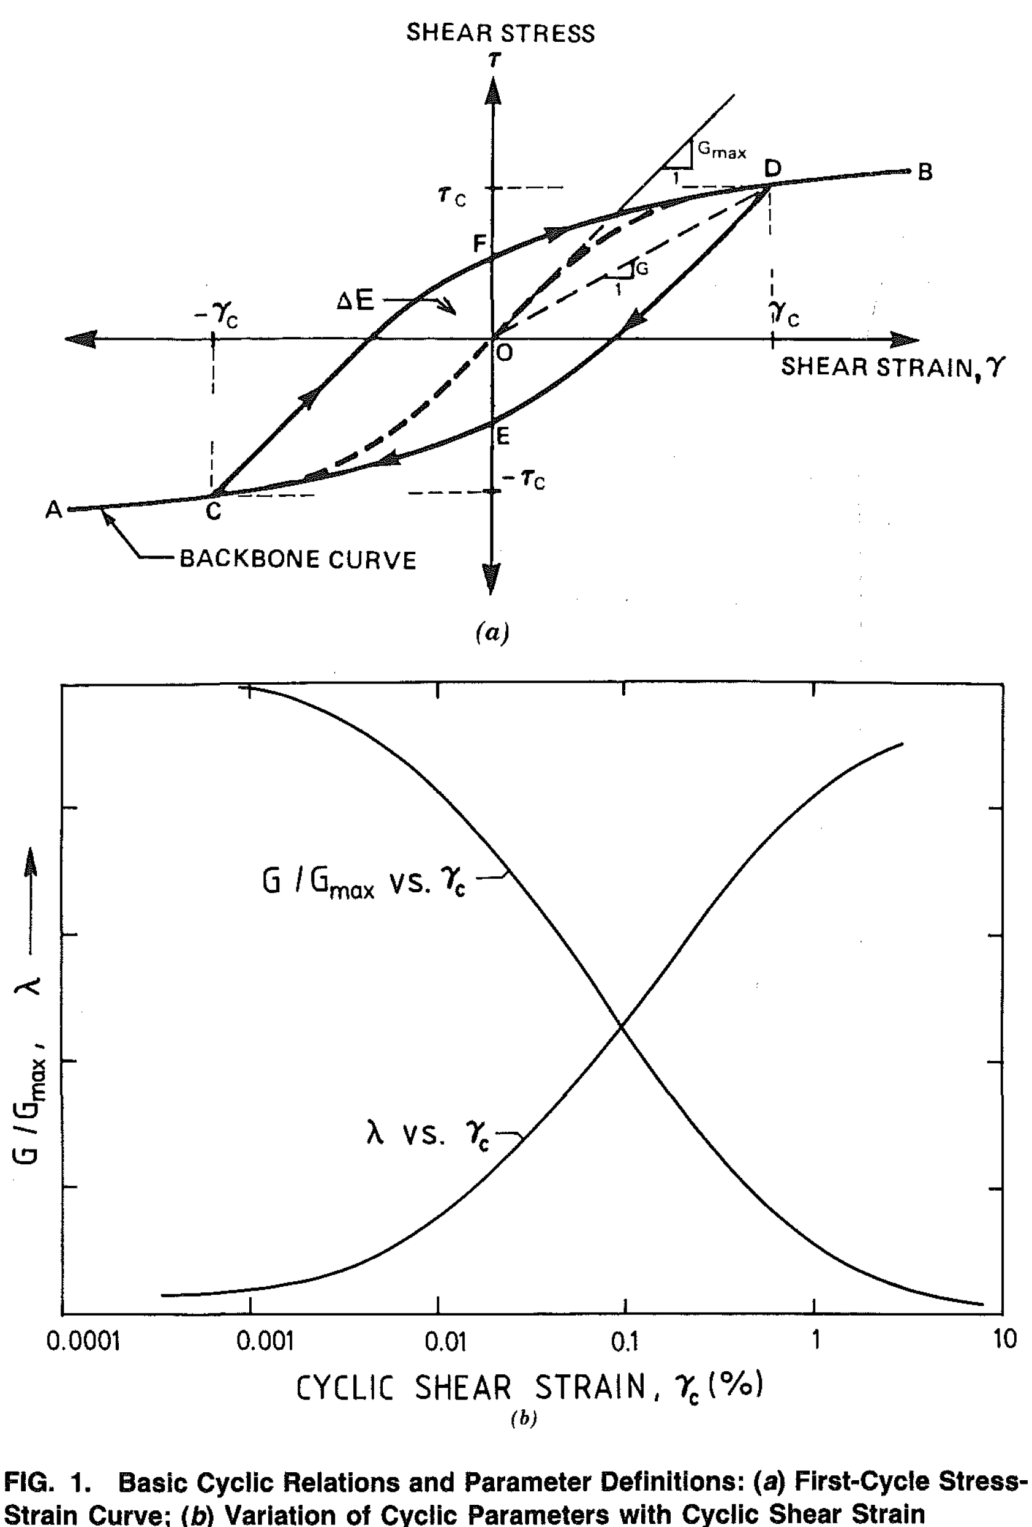
Deepsoil
TD Nonlinear soil response modeling software, version 6.1 (Y. Hashash et al. 2015)
Model parameters:
Dynamic soil properties: shear modulus and damping ratio curves
Soil profile: h, ρ, and V_{s} (or G_{max})
Input motion: shear motion
Empirical mega-thrust recordings in Japan and Chile (presented here; work accomplished with Osama Abuhajar)
Synthetic mega-thrust motions for Cascadia subduction zone (for Frontiers paper)

Slide 9
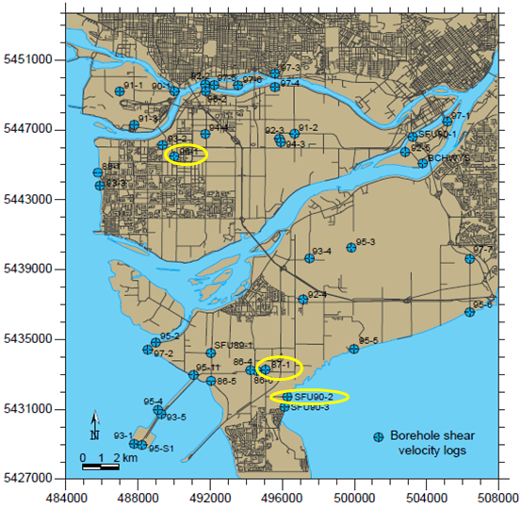
Fraser river delta (FRD)
Selected three ‘representative’ 1D soil profiles of the FRD
Borehole locations with downhole Vs profiling accomplished in the 1990’s (Clague et al. 1998, Hunter et al. 1998)
96-1 primarily silty site
87-1 primarily sandy site
90-2 alternating sands and silts
 | Holocene | Pleistocene
96-1 | 302 m | 540 m
87-1 | 180 m | 540 m
90-2 | 100 m | 550 m

Slide 10
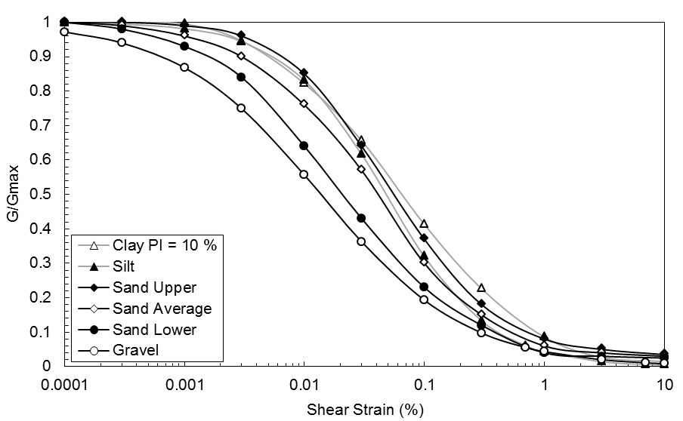
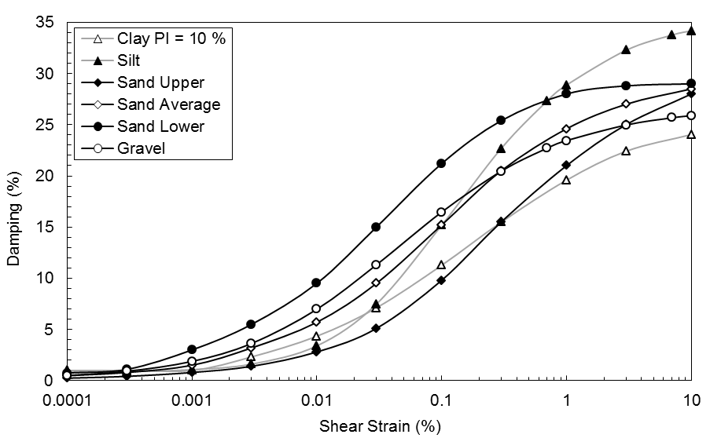
Dynamic soil behaviour
Performed literature search for most appropriate shear modulus reduction and damping curves (Seed et al. 1986, Vucetic & Dobry 1991, Darendeli 2001)
Differences in nonlinear behaviour between sand, clay, and silt
Soil densities and unit weights from Hunt (2005)

Slide 11
V_{s} profiles
Downhole V_{S} profiling to base of Holocene deltaic sediments is 100-180 m depth
Depths and V_{S} of glacial Pleistocene sediments and Tertiary clastic bedrock provided by J. Hunter (pers. comm.)
Relatively similar Vs profiles → differences primarily in assigned dynamic soil behaviour

Slide 12
Empirical input motions
Selected large subduction earthquake recordings in Japan and Chile
Japan: borehole recordings at depths equivalent to input V_{S} (~1550 m/s)
Chile: two rock sites, and deconvolved surface motions at soil sites using detailed 1D soil profiles from Molnar et al. (2015)
JAPAN
M9: 125 - 570 km
M8.2: 1015 - 1460 km
M8: 125- 710 km
CHILE
M8.8: 63-325 km
M_{S}7.8: ~225 km

Slide 13
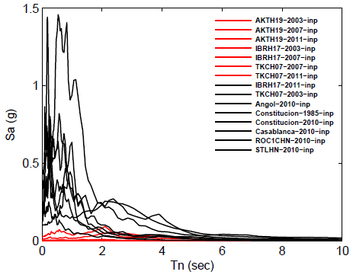
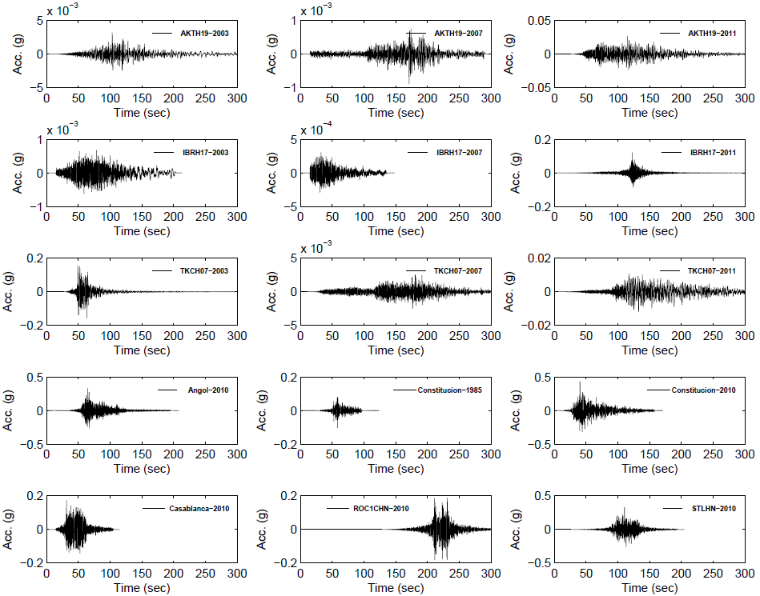
Input Motions
Time series and response spectra

Slide 14
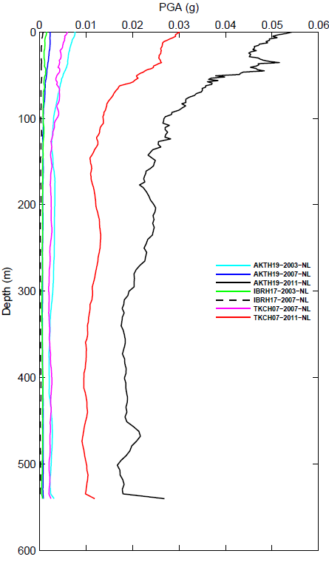
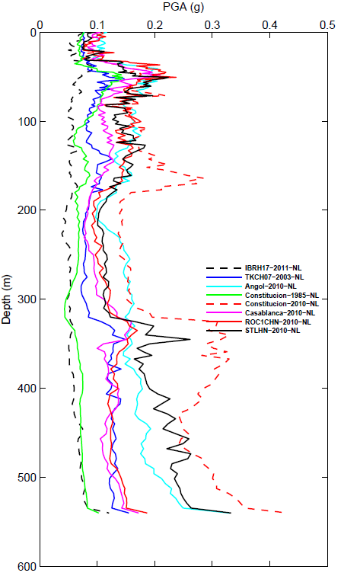
TD-NL modeling Results
Peak ground acceleration (PGA):
Amplification towards surface when input PGA is < 0.1 g
Deamplification at particular depths when PGA > 0.1 g
Input PGA
< 0.1 g
Input PGA
> 0.1 g

Slide 15
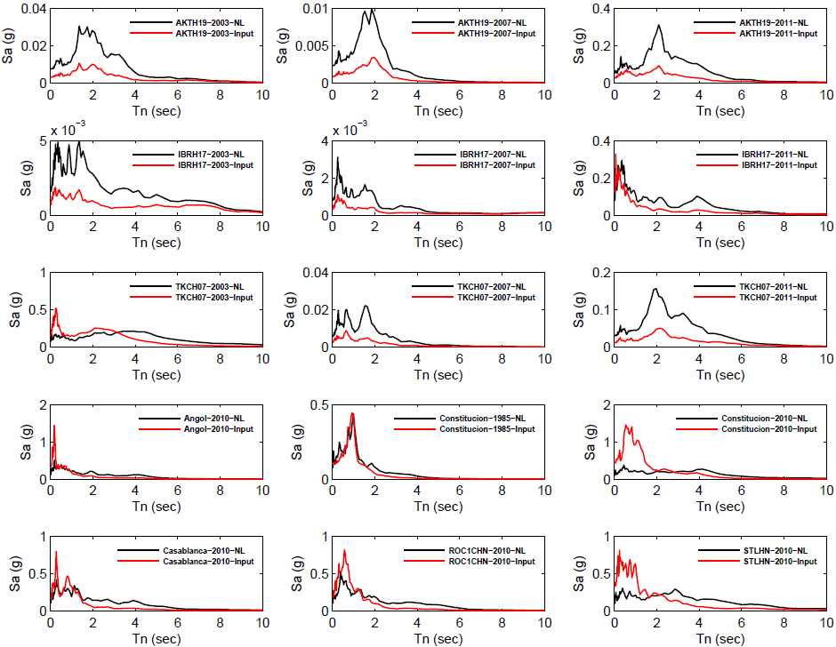
Response spectra
Comparison of input and surface acceleration response spectra for 87-1

Slide 16
Response spectra
Comparison of input and surface acceleration response spectra for 87-1
Deamplification
when PGA > 0.1 g
[Always expect amplification at 2 - 6 s periods (?)]

Slide 17
Comparison between three sites
Observations for FRD sand and silt soil profiles relatively consistent
Amplification
Deamplification

Slide 18
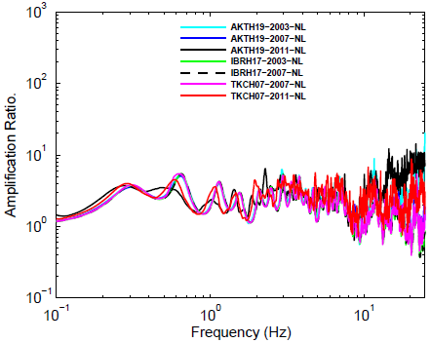
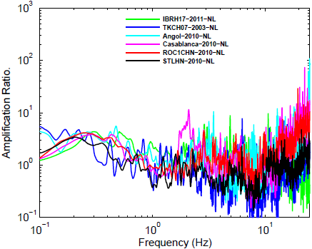
Spectral amplification
Surface/input amplification ratios for 87-1
Consistent “linear’ response at low input motions
‘Nonlinear’ response at high input motions appears as broadening of fundamental peak; a shift to lower frequency (?)
Input PGA < 0.1 g
Input PGA > 0.1 g

Slide 19
Summary
Observations for FRD sand and silt soil profiles relatively consistent
Differences in dynamic soil behaviour (sand, silt, or mixture of both) are “minor” (?) compared to degree and depth of impedance contrasts
Our simulated results suggest that (short period) nonlinear soil response on the FRD will “triggered” at ~0.1 g
“Evidence of nonlinear behavior becomes apparent beyond a threshold acceleration of ∼100 to 200 gal [0.1 - 0.2 g]” (Beresnev & Wen 1996)
What 1D soil response behaviour is expected for Cascadia mega-thrust scenarios? → ongoing work… input synthetic motions from Ghofrani and Atkinson’s EXSIM modeling

