Slide 1

Tools for Infrastructure System Resilience Evaluation
Jingjing Kong, Post Doctoral Fellow
Slobodan P. Simonović, Professor
Sep. 28 2016

Slide 2
2|
Research Objectives and Plan
Introduction
Project task 6: Tool for mapping resilience of urban regions across Canada for all hazards
Objectives
Development of the interdependent infrastructure system resilience assessment method
Use of resilience for assessment of multi hazard impacts on infrastructure systems
Plan
Development of interdependent infrastructure system resilience model
Development of probabilistic multi hazard infrastructure system resilience model
Case study: Greater Toronto Area (GTA) energy infrastructure system
Infrastructure System Resilience
Kong and Simonović
K

Slide 3
3|
Determinant Model of Infrastructure System Resilience
Infrastructure System Model
Information network
Power grid
Water supply network
Street network
Multi-layer Infrastructure Network
Infrastructure System Resilience
Kong and Simonović
K

Slide 4
4|
Determinant Model of Infrastructure System Resilience
Inter-Network Interdependences
Infrastructure System Resilience
Kong and Simonović
S

Slide 5
5|
Determinant Model of Infrastructure System Resilience
Infrastructure System Resilience
Redundancy
Infrastructure System Resilience
Kong and Simonović
S

Slide 6
6|
Determinant Model of Infrastructure System Resilience
Numerical Test
Infrastructure System Resilience
Kong and Simonović
K

Slide 7
7|
Determinant Model of Infrastructure System Resilience
Results
Infrastructure System Resilience
Kong and Simonović
K

Slide 8
8|
Probabilistic Model of Multi Hazard Resilience
Multi Hazard Relations
Single impacts; Joint impacts; Conditional impacts; Combination
Temporal relations of two hazards
(T-a)
(T-b)
(T-c)
(T-d)
(T-e)
Spatial relations of two hazards
(S-a)
(S-b)
(S-c)
(S-d)
Infrastructure System Resilience
Kong and Simonović
S

Slide 9
9|
Probabilistic Model of Multi Hazard Resilience
Analysis Framework of Multi Hazards Impacts
Direct damage probability
Indirect damage probability
Intra-network Interdependence
Sector specific
Inter-network Interdependence
  Topology- based method
  Flow-based method
Indirect damage probability
Multi hazards evolution process
Infrastructure System Resilience
Kong and Simonović
K

Slide 10
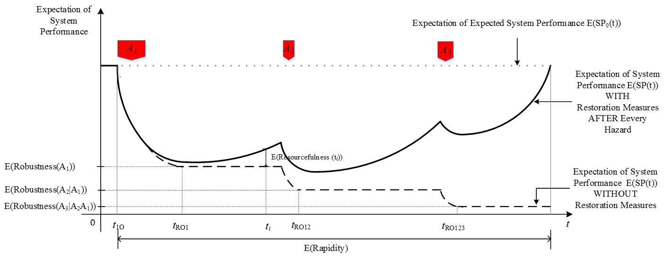
10|
Probabilistic Model of Multi Hazard Resilience
Probabilistic Multi Hazard Resilience Metric
Infrastructure System Resilience
Kong and Simonović
S

Slide 11
11|
Probabilistic Model of Multi Hazard Resilience
Restoration Model and Simulation Process
Restoration Strategy Model
Infrastructure System Resilience
Kong and Simonović
K

Slide 12
12|
Case Study: GTA Energy Infrastructure System
GTA Three-layer Energy Infrastructure Network
Infrastructure System Resilience
Kong and Simonović
K

Slide 13
13|
Case Study: GTA Energy Infrastructure System
Network Interdependence Model
Intra-network
  Electric Transmission Network
    ML Model
  Gas Transmission Network & Oil Transmission Network
    Flow un-redistribution model
Inter-network
  Gas-fired eclectic plants are supported by the nearest gas stations.
  Gas and oil nodes are powered by the nearest electric substations.
Infrastructure System Resilience
Kong and Simonović
K

Slide 14
14|
Case Study: GTA Energy Infrastructure System
Disaster Scenario: Sequential Hurricane and Flood
Hazards:
Hurricane - 120 mph
Flood > 10 feet (24 hours later)
Infrastructure System Resilience
Kong and Simonović
K

Slide 15
15|
Case Study: GTA Energy Infrastructure System
Multi Hazard Impacts
Direct impacts of Hurricane
  Electric substation
  Transmission tower
  Direct impacts of Flood
    Overground facilities 0.30 (EP), 0.15(TS), 0.40( others).
    Underground and under marine facilities
  Direct Impacts of Sequential Hurricane and Flood
  Indirect Impacts of Sequential Hurricane and Flood
S

Slide 16
16|
Case Study: GTA Energy Infrastructure System
Infrastructure System Resilience
SP_{physical}=
Number of Functional Nodes
Network Size
Un-impacted Population
SP_{functional}=
Population
Infrastructure System Resilience
Kong and Simonović
S

Slide 17
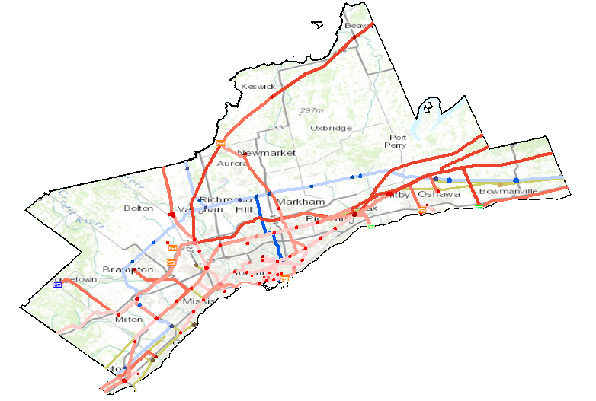
17|
Case Study: GTA Energy Infrastructure System
Infrastructure Damage Level under Sequential Hurricane and Flood
S
Notes:
Editing

Slide 18
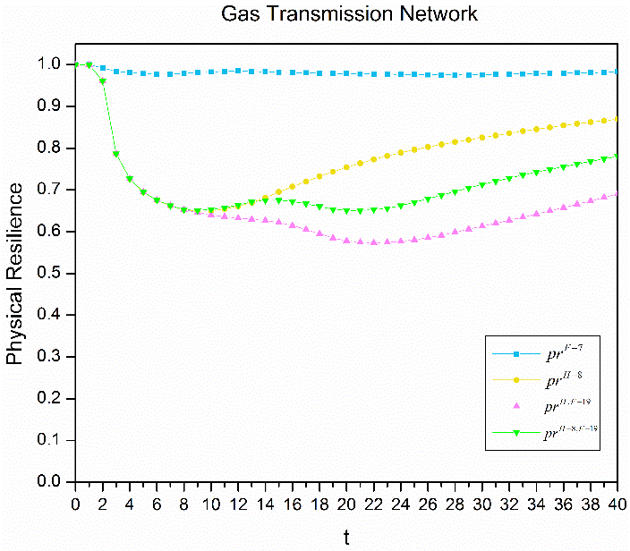
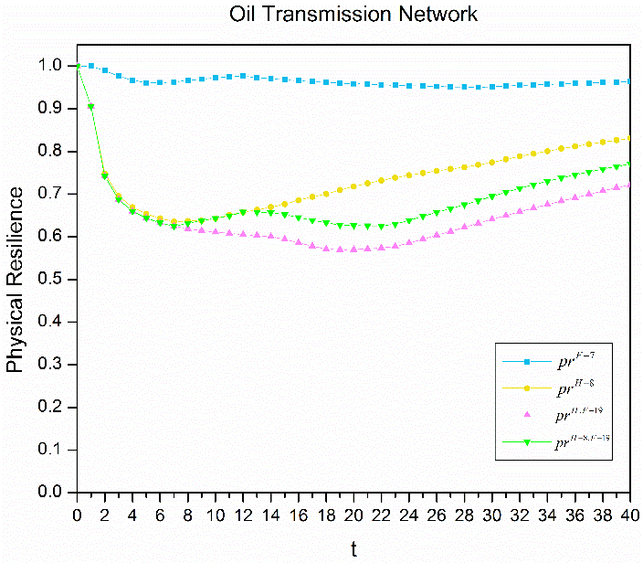
18|
Case Study: GTA Energy Infrastructure System
Multi Hazard Physical Resilience of Infrastructure Networks
(a)
(b)
(c)
(d)
(a)
(b)
(c)
(d)
(a)
(b)
(c)
(d)
(a)
(b)
(c)
(d)
S

Slide 19
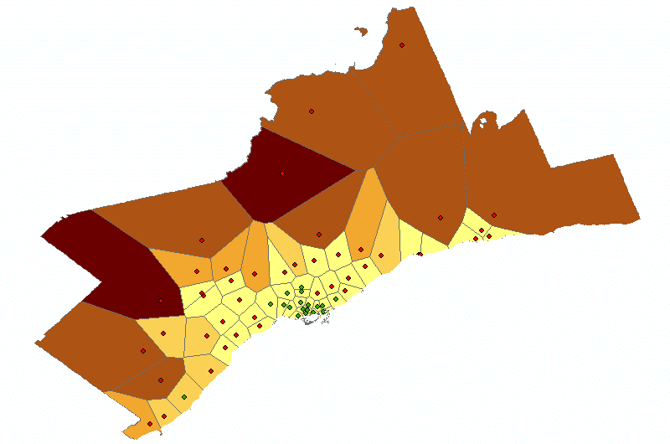
19|
Case Study: GTA Energy Infrastructure System
Infrastructure Function Loss Level under Sequential Hurricane and Flood
S

Slide 20
20|
Case Study: GTA Energy Infrastructure System
Multi Hazard Functional Resilience of Infrastructure Networks
F-(a)
F-(b)
F-(c)
F-(d)
P-(a)
P-(b)
P-(c)
P-(d)
Infrastructure System Resilience
Kong and Simonović
S

Slide 21
21|
Case Study: GTA Energy Infrastructure System
Conclusions
Multi hazard resilience is not the simple sum of single hazard resilience, and is bigger or smaller than the sum of single hazards resilience.
Interaction of multi hazard impacts is the key point in resilience assessment.
  Multi hazards’ joint impacts, conditional impacts and combination of them are different from the diverse multi hazard spatial and temporal relations.
  Cascading failure and cascading recovery make the resilience evaluation more complicated.
Functional resilience is always higher than the physical resilience.
Addition of hazard occurrence probabilities and economic loss can modify cumulative resilience into risk value.
Infrastructure System Resilience
Kong and Simonović
K

Slide 22
22|
Research Outcomes
Journal Papers
  Kong, J., and S. P. Simonovic (2016), An Original Model of Infrastructure System Resilience, Reliability Engineering and System Safety, under review
  Kong, J., and S. P. Simonovic (2016), Probabilistic multi hazards resilience model of interdependent infrastructure system, Risk Analysis, in preparation
  Kong, J., and S. P. Simonovic (2016), Multi hazards resilience of Great Toronto Area energy infrastructure system, Risk Analysis, in preparation
Conference Paper
  Kong, J., and S. P. Simonovic (2016), “An original model of infrastructure system resilience”, Proceedings, CSCE Annual Meeting: Resilient Infrastructure, NDM515-1 – NDM515-10, June 1-4, London, Canada.
Infrastructure System Resilience
Kong and Simonović
S

Slide 23
Thank you!
Infrastructure System Resilience
Kong and Simonović

