Slide 1
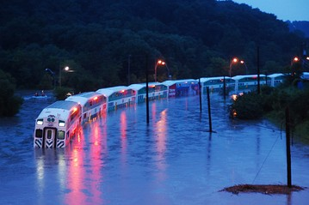
Change in Flood Risk across Canada under Changing Climate
Ayushi Gaur
(MESc. Candidate)
Slobodan P. Simonović
(supervisor)

Slide 2
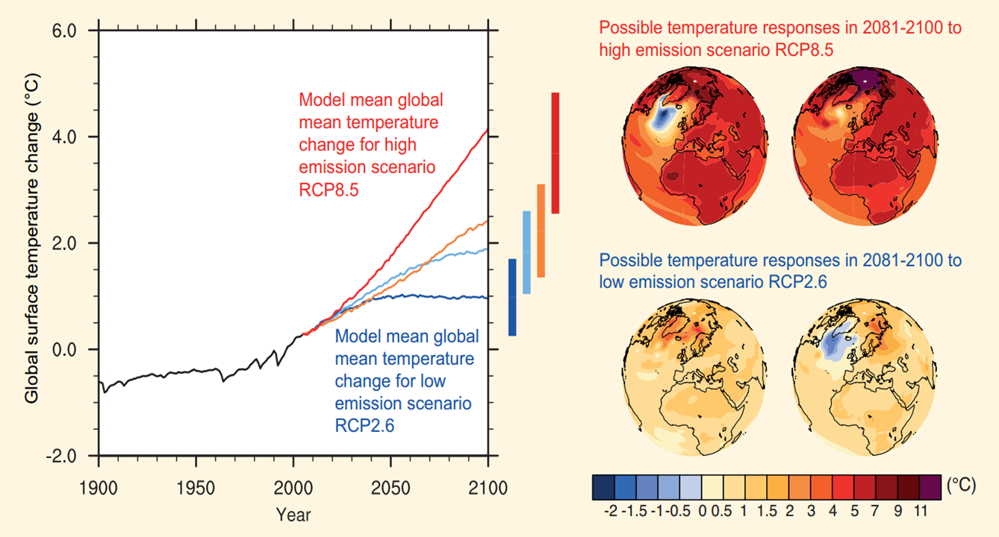
2|
Research objective
To analyze changes in flood risk patterns across Canada under changing climate.
Change in Flood Risk across Canada under Changing Climate
Gaur and Simonović

Slide 3
3|
Methodology
Low resolution future runoff projection
Macro-scale hydrodynamic model
High resolution flow projection
GCM based
CamaFlood (Catchment-Based hydrodynamic model)
Low resolution (2°-5°)
Energy balance
Land surface schemes
High resolution flow
10-25km resolution
Sub-grid topographic parameters
Change in Flood Risk across Canada under Changing Climate
Gaur and Simonović

Slide 4
4|
Hydrodynamic model selection
Criteria
Should be state-of-the-art
Could be used at regional/continental/global scale
Should have a routing and floodplain mapping component
CamaFlood model have been used in large scale studies (Hirabayashi et al. 2013) and was chosen for this study
Change in Flood Risk across Canada under Changing Climate
Gaur and Simonović

Slide 5
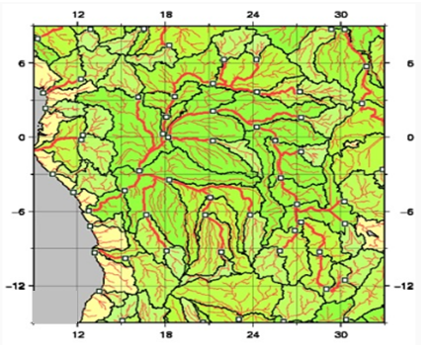
5|
CamaFlood
Grid –based river and floodplain routing calculations
Runoff forcing from land surface schemes within GCMs used as input
Flow calculation in each grid specific unit-catchment
Water storage is the only prognostic variable, other variables are derived empirically
Up-scaled river network map is prepared using Flexible Location of Waterways ( FLOW ) method
Change in Flood Risk across Canada under Changing Climate
Gaur and Simonović

Slide 6
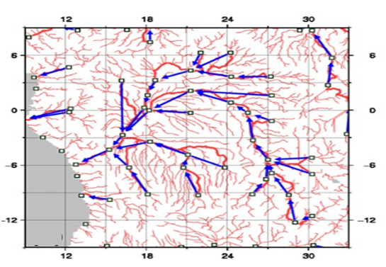
6|
FLOW method
Outlet pixel of each grid box is decided-pixel with largest upstream area
River network map is prepared tracing the fine resolution flow direction map
Sub-grid characteristics–channel length, channel altitude, distance to downstream, unit-catchment area and flood elevation profile are derived by FLOW method.
Change in Flood Risk across Canada under Changing Climate
Gaur and Simonović

Slide 7
7|
CamaFlood model assessment
NARR reanalysis flow data used to simulate river flow across Canada and flooded area for the Prairies region over the period 1993-2007
Flood area simulated by CamaFlood is validated using multi-satellite flood extent data (Pringent et al, 2007)
River discharge simulated by CamaFlood is validated with the observed daily flow data obtained from HYDAT for 211 RHBN stations located across Canada
River and floodplain Manning’s coefficients are calibrated for the model
Change in Flood Risk across Canada under Changing Climate
Gaur and Simonović

Slide 8
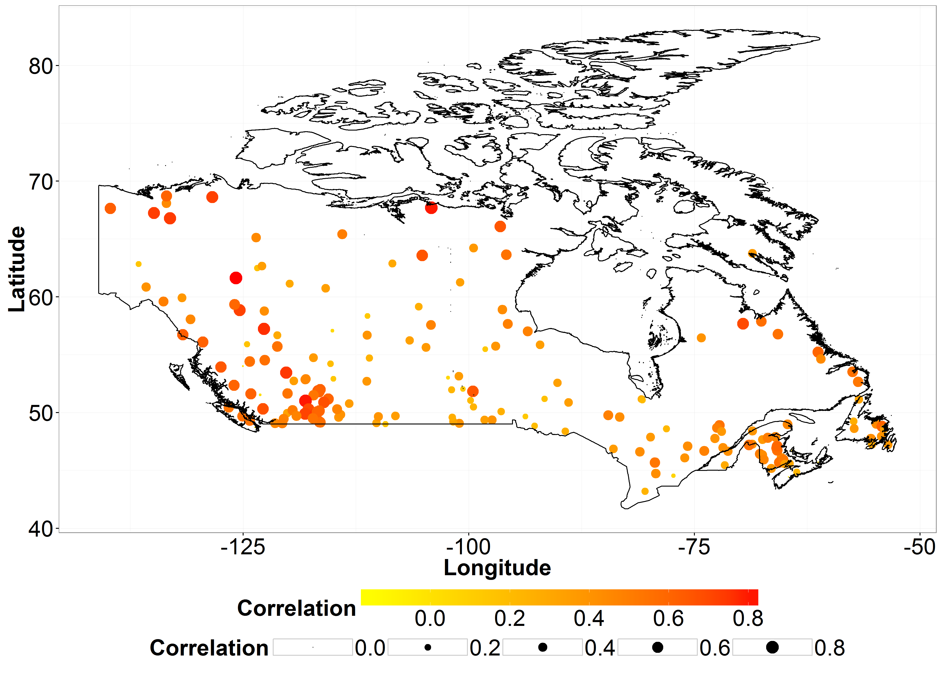
8|
CamaFlood model performance
Change in Flood Risk across Canada under Changing Climate
Gaur and Simonović

Slide 9
9|
Future flow projection across Canada
Continuous daily simulation of historical (1961-2016) and future flow projections (2017-2100) across Canada
Input daily flow data obtained from CanESM2 GCM taking future emission scenario RCP 4.5
Change in 100 year ad 250 year return period flood magnitudes estimated
Flood frequency analysis is performed by fitting the annual maximum flows using Generalized Extreme Value (GEV) distribution
Scale, shape and location parameters estimated using method of moments
Change in Flood Risk across Canada under Changing Climate
Gaur and Simonović

Slide 10
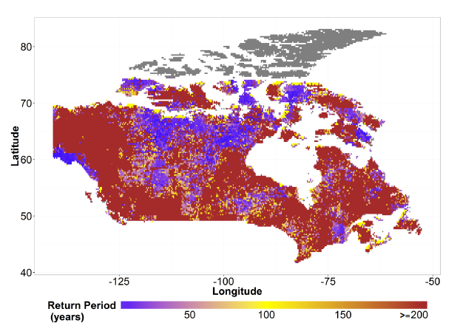
10|
Projected change: 100 year flood
Change in Flood Risk across Canada under Changing Climate
Gaur and Simonović
Notes:
How the 100 year return period flood event will change in future changing climate with RCP 4.5

Slide 11
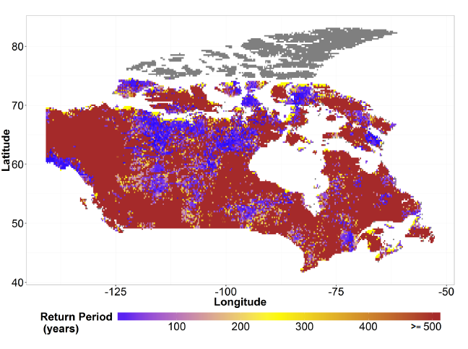
11|
Projected change: 250 year flood
Change in Flood Risk across Canada under Changing Climate
Gaur and Simonović

Slide 12
12|
Future work
Detailed assessment of CamaFlood model for its performance towards predicting flows across Canada
Exploration of sensitivity of model output to parameters
Quantification of uncertainty contributed by different GCMs, RCPs, parameter values
Development of a methodology to estimate higher resolution flood inundation magnitudes , more relevant for flood risk assessment
Quantification of the effect of bias-correction of GCM flow data on future flow projections
Change in Flood Risk across Canada under Changing Climate
Gaur and Simonović

Slide 13
13|
Conclusions
Non-stationarity in climate must be accounted for while making future flow projections
CamaFlood is a state-of-the-art hydrodynamic model that can be used to perform flood risk assessment across Canada
Initial assessment of the model shows promising results
Model performance is found sensitive to parameters and location of analysis
Future work involves further assessment of model and quantification of uncertainty from relevant sources
Change in Flood Risk across Canada under Changing Climate
Gaur and Simonović

Slide 14
Thank you!

